Slide 1
Introduction to OpenMP
曾奕倫
Department of Computer Science & Engineering
Yuan Ze University

Slide 2
Outline
EETimes news articles regarding parallel computing
Simple C programs
Simple OpenMP programs
How to compile & execute OpenMP programs

Slide 3
A Number of EETimes Articles
Researchers report progress on parallel path (2009/08/24) [link]
Parallel software plays catch-up with multicore (2009/06/22) [link]
Cadence adds parallel solving capabilities to Spectre (2008/12/15) [link]
Mentor releases parallel timing analysis and optimization technology (2008/10/13) [link]

Slide 4
A Number of EETimes Articles
Researchers report progress on parallel path (2009/08/24) [link]
“The industry expects processors with 64 cores or more will arrive by 2015, forcing the need for parallel software, said David Patterson of the Berkeley Parallel Lab. Although researchers have failed to create a useful parallel programming model in the past, he was upbeat that this time there is broad industry focus on solving the problem.”
“In a separate project, one graduate student used new data structures to map a high-end computer vision algorithm to a multicore graphics processor, shaving the time to recognize an image from 7.8 to 2.1 seconds.”

Slide 5
A Number of EETimes Articles
Parallel software plays catch-up with multicore (2009/06/22) [link]
“Microprocessors are marching into a multicore future to keep delivering performance gains …... But mainstream software has yet to find its path to using the new parallelism.”
"Anything performance-critical will have to be rewritten," said Kunle Olukotun, director of the Pervasive Parallelism Lab at Stanford University, one of many research groups working on the problem seen as the toughest in computer science today.
Some existing multiprocessing tools, such as OpenMP, now applied at the chip level. Intel and others have released libraries to mange software threads. Startups such as Critical Blue (Edinburgh, Scotland) and Cilk Arts Inc. (Burlington, Mass.) have developed tools to help find parallelism in today's C code.
Freescale has doubled the size of its multicore software team in preparation for such offerings, Cole said.

Slide 6
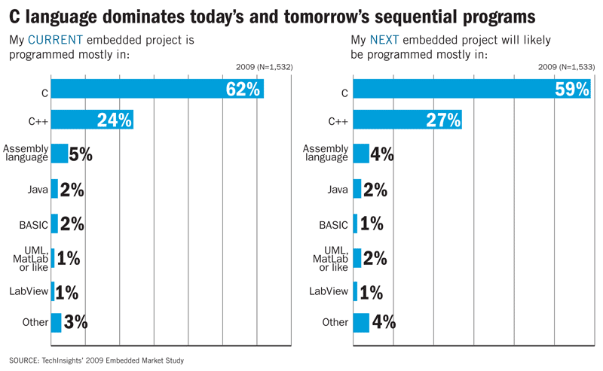
A Number of EETimes Articles
Parallel software plays catch-up with multicore (2009/06/22) [link]

Slide 7
The Textbook
Barbara Chapman, Gabriele Jost, and Ruud van der Pas,
Using OpenMP – Portable Shared Memory Parallel Programming,
The MIT Press, 2008
The book can be viewed on-line within .yzu.edu.tw domain: [Link]

Slide 8
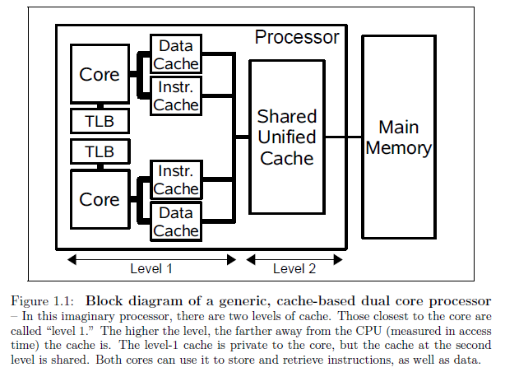
Block Diagram of a Dual-core CPU

Slide 9
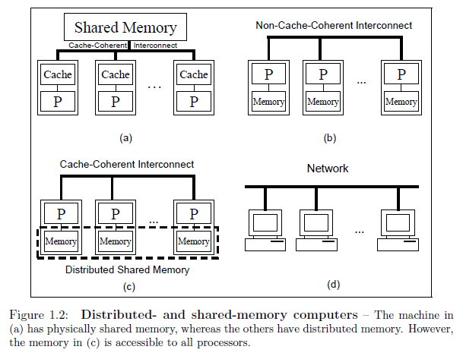
Shared Memory and Distributed Memory

Slide 10
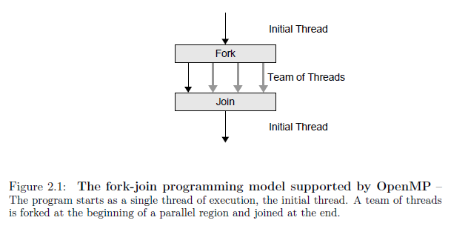
Fork-Join Programming Model

Slide 11
Environment Used in this Tutorial
Ubuntu Linux version 9.04 Desktop Edition
(64-bit version)
gcc (version 4.3.3)
  $ gcc --version
  $ gcc –v
gcc version 4.1.2 (on Luna): OK

Slide 12
Your First C Program
(HelloWorld.c)
#include <stdio.h>
int main()
{
printf("Hello World\n");
}

Slide 13
Compiling Your C Program
Method #1
$ gcc HelloWorld.c
/* the executable file “a.out” (default) will be generated
*/
Method #2
$ gcc -o HelloW HelloWorld.c
/* the executable file “HelloW” (instead of “a.out”) will
* be generated
*/

Slide 14
Executing Your First C Program
Method #1
$ ./a.out
/* if “$ gcc HelloWorld.c” was used. */
Method #2
$ ./HelloW
/* if “$ gcc -o HelloW HelloWorld.c” was used */

Slide 15
A Simple Makefile
(for HelloWorld.c)
Makefile
HelloWorld: HelloWorld.c
gcc -o HelloWorld HelloWorld.c
The first line: “HelloWorld” is the binary target.
The second line (gcc –o …), which is a build rule, must begin with a tab.
To compile, just type
$ make

Slide 16
C Program – For Loop & printf
(HelloWorld_2.c)
#include <stdio.h>
int main()
{
int i;
for (i=1; i<=10; i++)
{
printf("Hello World: %d\n", i);
}
}

Slide 17
Your First OpenMP Program
(omp_test00.c)
#include <omp.h>
#include <stdio.h>
int main()
{
#pragma omp parallel
printf("Hello from thread %d, nthreads %d\n", omp_get_thread_num(),
omp_get_num_threads() );
}

Slide 18
#pragma Directive
The ‘#pragma’ directive is the method specified by the C standard for providing additional information to the compiler, beyond what is conveyed in the language itself.
(Source: http://gcc.gnu.org/onlinedocs/cpp/Pragmas.html )

Slide 19
#pragma Directive
Each implementation of C and C++ supports some features unique to its host machine or operating system. Some programs, for instance, need to exercise precise control over the memory areas where data is placed or to control the way certain functions receive parameters. The #pragma directives offer a way for each compiler to offer machine- and operating system-specific features while retaining overall compatibility with the C and C++ languages. Pragmas are machine- or operating system-specific by definition, and are usually different for every compiler.
(Source: http://msdn.microsoft.com/en-us/library/d9x1s805%28VS.71%29.aspx )

Slide 20
#pragma Directive
Computing Dictionary
pragma
(pragmatic information) A standardized form of comment which has meaning to a compiler. It may use a special syntax or a specific form within the normal comment syntax. A pragma usually conveys non-essential information, often intended to help the compiler to optimize the program.

Slide 21
Compiling Your OpenMP Program
Method #1
$ gcc –fopenmp omp_test00.c
/* the executable file “a.out” will be generated
*/
Method #2
$ gcc –fopenmp -o omp_test00 omp_test00.c
/* the executable file “omp_test00” will be generated
*/

Slide 22
Executing Your OpenMP Program
Method #1
$ a.out
/* if “a.out” has been generated. */
Method #2
$ omp_test00
/* if “omp_test00” has been generated */

Slide 23
UNIX/Linux Shell
BASH
CSH
TCSH
What is my current shell?
  $ echo $0
What is my login shell?
  $ echo $SHELL

Slide 24
The OMP_NUM_THREADS Environment Variable
BASH (Bourne Again Shell)
  $ export OMP_NUM_THREADS=3
  $ echo $OMP_NUM_THREADS
CSH/TCSH
  $ setenv OMP_NUM_THREADS 3
  $ echo $OMP_NUM_THREADS
Exercise: Change the environment variable to different values and then execute the program omp_test00.

Slide 25
#pragma omp parallel for
(omp_test01.c)
#include <omp.h>
#include <stdio.h>
int main()
{
int i;
#pragma omp parallel for
for (i=1; i<=10; i++) {
printf("Hello: %d\n", i );
}
}

Slide 26
#pragma omp parallel for
The purpose of the directive #pragma omp parallel for:
  Both to create a parallel region and to specify that the iterations of the loop should be distributed among the executing threads
  A parallel work-sharing construct

Slide 27
#pragma omp parallel for
(omp_test02.c)
#include <omp.h>
#include <stdio.h>
int main()
{
int i;
#pragma omp parallel for
for (i=1; i<=10; i++) {
printf("Hello: %d (thread=%d, #threads=%d)\n", i, omp_get_thread_num(),
omp_get_num_threads() );
} /*-- End of omp parallel for --*/
}

Slide 28
Executing omp_test02
$ gcc -fopenmp -o omp_test02 omp_test02.c
$ export OMP_NUM_THREADS=1
$ ./omp_test02
$ export OMP_NUM_THREADS=2
$ ./omp_test02
$ export OMP_NUM_THREADS=4
$ ./omp_test02
$ export OMP_NUM_THREADS=10
$ ./omp_test02
$ export OMP_NUM_THREADS=100
$ ./omp_test02

Slide 29
Executing omp_test02
The work in the for-loop is shared among threads.
You can specify the number of threads (for sharing the work) via the OMP_NUM_THREADS environment variable.

Slide 30
OpenMP: shared & private data
Data in an OpenMP program is either shared by threads in a team, or is private.
Private data: Each thread has its own copy of the data object, and hence the variable may have different values for different threads.
Shared data: The shared data will be shared among the threads executing the parallel region it is associated with; each thread can freely read or modify the values of shared data.

Slide 31
OpenMP: shared & private data
(omp_test03.c)
#include <omp.h>
#include <stdio.h>
int main()
{
int i;
int a=101, b=102, c=103, d=104;
#pragma omp parallel for shared(c,d) private(i,a,b)
for (i=1; i<=10; i++)
{
a = 201;
d = 204;
printf("Hello: %d (thread_id=%d, #threads=%d), a=%d, b=%d, c=%d, d=%d\n",
i,
omp_get_thread_num(), omp_get_num_threads(),
a, b, c, d );
} /*-- End of omp parallel for --*/
printf("a=%d, b=%d, c=%d, d=%d\n", a, b, c, d);
}

Slide 32
Executing omp_test03
Hello: 5 (thread_id=1, #threads=3), a=201, b=-1510319792, c=103, d=204
Hello: 6 (thread_id=1, #threads=3), a=201, b=-1510319792, c=103, d=204
Hello: 7 (thread_id=1, #threads=3), a=201, b=-1510319792, c=103, d=204
Hello: 8 (thread_id=1, #threads=3), a=201, b=-1510319792, c=103, d=204
Hello: 1 (thread_id=0, #threads=3), a=201, b=4195840, c=103, d=204
Hello: 2 (thread_id=0, #threads=3), a=201, b=4195840, c=103, d=204
Hello: 3 (thread_id=0, #threads=3), a=201, b=4195840, c=103, d=204
Hello: 4 (thread_id=0, #threads=3), a=201, b=4195840, c=103, d=204
Hello: 9 (thread_id=2, #threads=3), a=201, b=0, c=103, d=204
Hello: 10 (thread_id=2, #threads=3), a=201, b=0, c=103, d=204
a=101, b=102, c=103, d=204
#include <omp.h>
#include <stdio.h>
int main()
{
int i;
int a=101, b=102, c=103, d=104;
#pragma omp parallel for shared(c,d) private(i,a,b)
for (i=1; i<=10; i++)
{
a = 201;
d = 204;
printf("Hello: %d (thread_id=%d, #threads=%d), a=%d, b=%d, c=%d, d=%d\n",
i,
omp_get_thread_num(), omp_get_num_threads(),
a, b, c, d );
} /*-- End of omp parallel for --*/
printf("a=%d, b=%d, c=%d, d=%d\n", a, b, c, d);
}
(Assume that 3 threads are used.)

Slide 33
Race Condition
(omp_test04_p.c)
......
int main()
{
int i;
int a=0, b, c=0;
#pragma omp parallel for shared(a) private(i,c)
for (i=1; i<=50; i++)
{
a++;
for (b=0; b<=20000000; b++) { c++; c--; } /* for slowing down the thread */
a--;
printf("Hello: %d (thread_id=%d, #threads=%d), a=%d\n",
i,
omp_get_thread_num(), omp_get_num_threads(),
a);
} /*-- End of omp parallel for --*/
printf("a=%d\n", a);
}

Slide 34
Shared Data Can Cause Race Condition
An important implication of the shared attribute is that multiple threads might attempt to simultaneously update the same memory location or that one thread might try to read from a location that another thread is updating.
Special care has to be taken to ensure that neither of these situations occurs that accesses to shared data are ordered as required by the algorithm.
OpenMP places the responsibility for doing so on the user and provides several constructs that may help.

Slide 35
Matrix * Vector

Slide 36
Matrix * Vector
For example:

Slide 37
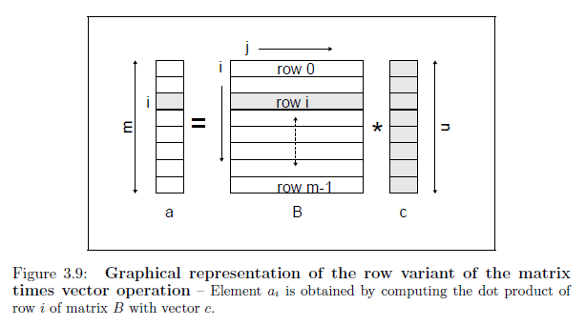
Matrix * Vector

Slide 38
Matrix * Vector – main()
/* Figure 3.5 */
int main(void)
{
double *a, *b, *c; int i, j, m, n;
printf("Please give m and n: ");
scanf("%d %d", &m, &n);
if ( (a=(double *)malloc(m*sizeof(double))) == NULL )
perror("memory allocation for a");
if ( (b=(double *)malloc(m*n*sizeof(double))) == NULL )
perror("memory allocation for b");
if ( (c=(double *)malloc(n*sizeof(double))) == NULL )
perror("memory allocation for c");
printf("Initializing matrix B and vector c\n");
for (j=0; j<n; j++)
c[j] = 2.0;
for (i=0; i<m; i++)
for (j=0; j<n; j++)
b[i*n+j] = i;
printf("Executing mxv function for m = %d n = %d\n", m, n);
(void) mxv(m, n, a, b, c);
free(a); free(b); free(c);
return(0);
}

Slide 39
Matrix * Vector – mxv() - sequential
/* Figure 3.7 */
void mxv( int m, int n,
double * a, double * b, double * c )
{
int i, j;
for (i=0; i<m; i++)
{
a[i] = 0.0;
for (j=0; j<n; j++)
a[i] += b[i*n+j]*c[j];
}
}

Slide 40
Matrix * Vector – mxv() - parallel
/* Figure 3.10 */
void mxv( int m, int n,
double * a, double * b, double * c )
{
int i, j;
#pragma omp parallel for default(none) \
shared(m,n,a,b,c) private(i,j)
for (i=0; i<m; i++)
{
a[i] = 0.0;
for (j=0; j<n; j++)
a[i] += b[i*n+j]*c[j];
} /*-- End of omp parallel for --*/
}

