Slide 1
OpenMP Language Features
曾奕倫
Department of Computer Science & Engineering
Yuan Ze University

Slide 2
Outline
OpenMP Constructs (Compiler Directives)
OpenMP Functions
OpenMP Clauses
OpenMP Environment Variables

Slide 3
OpenMP Features
OpenMP is an API for shared-memory parallel programming.
OpenMP consists of:
  A set of compiler directives and clauses
    E.g., #pragma omp parellel, shared, private
  A library of functions
    E.g., omp_get_num_threads(), #include <omp.h>
  A set of environment variables
    E.g., OMP_NUM_THREADS
OpenMP works in conjunction with:
  Fortran, C, and C++

Slide 4
OpenMP Constructs
#pragma omp parallel
#pragma omp for
#pragma omp sections
#pragma omp section
#pragma omp single
#pragma omp parallel for
#pragma omp parallel sections
#pragma omp barrier
#pragma omp critical

Slide 5
OpenMP Functions
omp_get_num_procs()
omp_get_num_threads()
omp_set_num_threads()
omp_get_thread_num()

Slide 6
OpenMP Clauses
shared
private
firstprivate
lastprivate
default
nowait
if
reduction
schedule

Slide 7
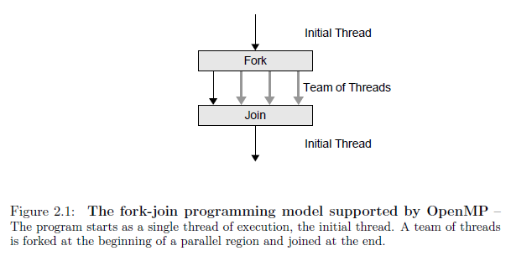
Fork-Join Programming Model

Slide 8
Fork-Join Programming Model
When the program begins execution, only a single thread (called the master thread) is active. The master thread executes the sequential portions of the algorithm.
At those points where parallel operations are required, the master threads forks (creates or awakens) additional threads.
The master thread and the created threads work concurrently through the parallel section.
At the end of the parallel code, the created threads die or are suspended, and the flow of control returns to the single master thread. This is called a join.

Slide 9
#pragma Directive
A compiler directive in C or C++ is called a pragma.
The word pragma is short for “pragmatic information.”
A pragma is a way to communicate information to the compiler. The information is nonessential in the sense that the compiler may ignore the information and still produce a correct object program. However, the information provided by the pragma can help the compiler optimize the program.

Slide 10
#pragma omp parallel
In OpenMP, a program without a parallel construct will be executed sequentially.
Syntax:
#pragma omp parallel [clauses]
structured block

Slide 11
#pragma omp parallel
When a thread encounters this construct, a team of threads is created to execute the associated parallel region.
Although this construct ensures that computations are performed in parallel, it does not distribute the work of the region among the threads in a team.
If the programmer does not use the appropriate syntax to specify the work-sharing action, the work will be replicated.
At the end of a parallel region, there is an implied barrier that forces all threads to wait until the work inside the region has been completed.
Only the initial thread (the master thread) continues execution after the end of the parallel region.

Slide 12
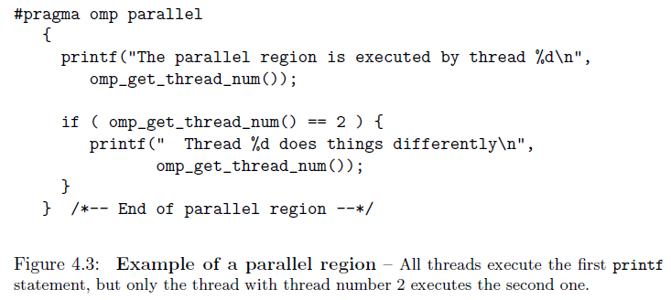
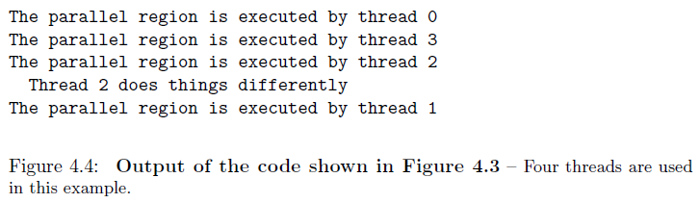
#pragma omp parallel
← barrier
Thread 2

Slide 13
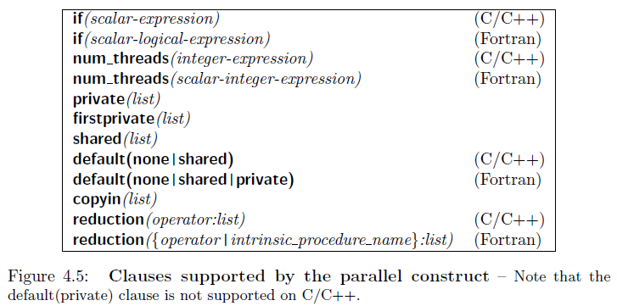
#pragma omp parallel

Slide 14
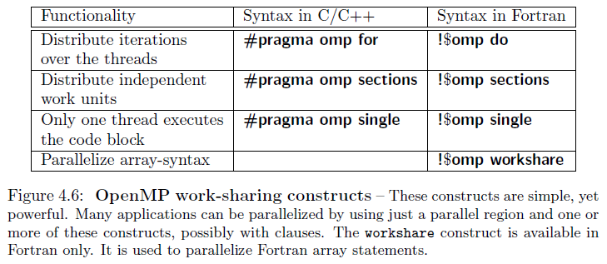
OpenMP Work-Sharing Constructs

Slide 15
Work-Sharing Constructs
A work-sharing construct (along with its terminating construct where appropriate) specifies a region of code whose work is to be distributed among the executing threads.
A work-sharing region must bind to an active parallel region in order to have an effect.
If a work-sharing directive is encountered in an inactive parallel region or in the sequential part of the program, it is simply ignored.

Slide 16
Work-Sharing Constructs - Barrier
A work-sharing construct does not launch new threads and does not have a barrier on entry.
By default, threads wait at a barrier at the end of a work-sharing region until the last thread has completed its share of the work.
However, the programmer can suppress the barrier by using the nowait clause.

Slide 17
#pragma omp for
At run time, the loop iterations are distributed across the threads.
Syntax:
#pragma omp for [clauses]
for-loop
(Note the lack of curly braces.)

Slide 18
#pragma omp for
Note: The identifiers start, end, and inc may be expressions.

Slide 19
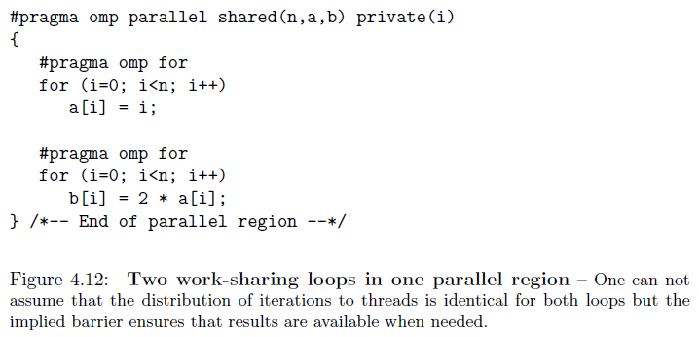
#pragma omp for
← An implied barrier (the 1st for-construct)
← An implied barrier (the 2nd for-construct)
← A barrier (parallel-construct)
Note that the second loop uses values of a that are defined in the first loop.

Slide 20
#pragma omp for
(omp_test07.c)
int main () {
#pragma omp parallel
{
funcA();
} /* All threads join master thread and terminate */
funcA(); /* “#pragma omp for” in funcA() will be ignored */
}
void funcA() {
int i;
#pragma omp for
for (i=0; i<5; i++) {
printf("func: i=%d, thread_id=%d, #threads=%d \n",
i, omp_get_thread_num(), omp_get_num_threads() );
}
}

Slide 21
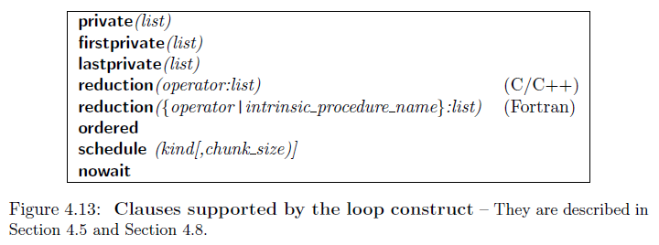
#pragma omp for

Slide 22
#pragma omp sections
#pragma omp section
Main Usage: Functional parallelism
“#pragma omp sections” is used to indicate the start of the construct.
“#pragma omp section” is used to mark each distinct section.
The construct’s most common use is to execute function or subroutine calls in parallel.
Each thread executes one code block at a time, and each code block will be executed exactly once. If there are fewer threads than code blocks, some or all of the threads execute multiple code blocks. If there are fewer code blocks than threads, the remaining threads will be idle.

Slide 23
#pragma omp sections
#pragma omp section
Syntax
(the construct should be enclosed by #pragma omp parallel):
#pragma omp sections [clauses]
{
#pragma omp section
structured-block
#pragma omp section
structured-block
……
}

Slide 24
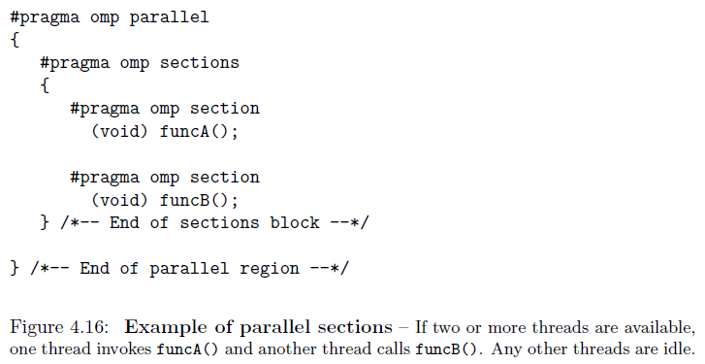
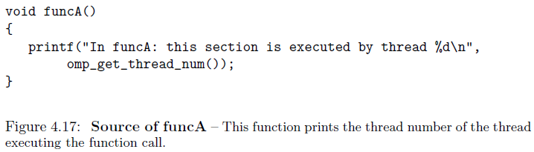
#pragma omp sections
#pragma omp section
← An implied barrier

Slide 25
#pragma omp sections
#pragma omp section
Figures 4.16 – 4.17
If two or more threads are available, function calls funcA() and funcB() are executed in parallel.
If only one thread is available, both calls to funcA() and funcB() are executed in sequential order.
  funcA() then funcB()
  funcB() then funcA()

Slide 26
#pragma omp sections
#pragma omp section
Load-balancing problem
  Occurs when threads have different amounts of work to do and thus take different amounts of time to complete.
  Some threads may wait a long time at the next barrier in the program, which means that the hardware resources are not being efficiently exploited.

Slide 27
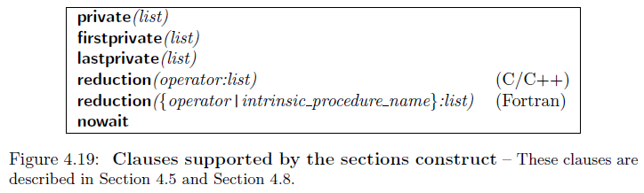
#pragma omp sections
#pragma omp section

Slide 28
#pragma omp single
The single construct indicates a block of code that should only be executed by one of the threads.
The construct does not state which thread should execute the code block; indeed, the thread chosen could vary from one run to another.
An implied barrier is at the end of the construct.
Syntax:
#pragma omp single [clauses]
structured-block

Slide 29
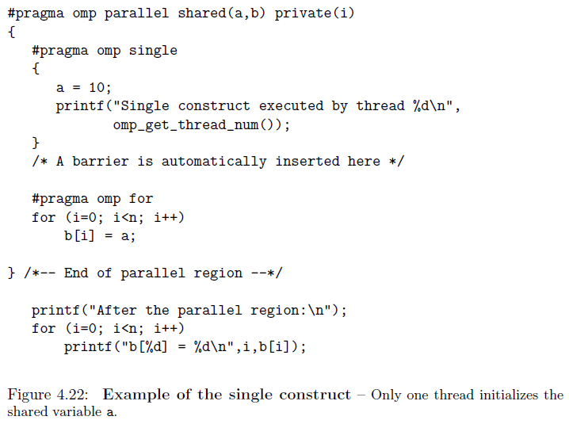
#pragma omp single
← An implied barrier

Slide 30
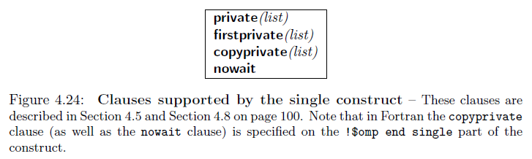
#pragma omp single

Slide 31
Combined Parallel Work-Sharing Constructs
Combined parallel work-sharing constructs are shortcuts that can be used when a parallel region comprises precisely one work-sharing construct.
The semantics of the shortcut directives are identical to explicitly specifying the parallel construct immediately followed by the work-sharing construct.
Main advantages of using combined constructs:
  Readability
  Performance
    One barrier only at the end of the construct

Slide 32
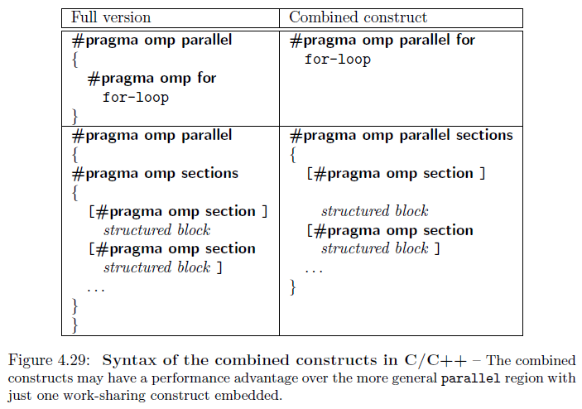
Combined Parallel Work-Sharing Constructs

Slide 33
#pragma omp parallel for
Note: The identifiers start, end, and inc may be expressions.

Slide 34
#pragma omp parallel for
The for loop must have canonical shape (shown in the previous slide).
The for loop must not contain statements that allow the loop to be exited prematurely. Examples include the break statement, return statement, exit statement, and goto statements to labels outside the loop.
The continue statement is allowed because its execution does not affect the number of loop iterations.
In the parallel for pragma, variables are by default shared, with the exception that the loop index variable is private.

Slide 35
#pragma omp barrier
A barrier is a point in the execution of a program where threads wait for each other; no thread in the team of threads it applies to may proceed beyond a barrier until all threads in the team have reached that point.
Many OpenMP constructs insert an implied barrier at the end of the construct.
Example: “omp_test06_2.c”

Slide 36
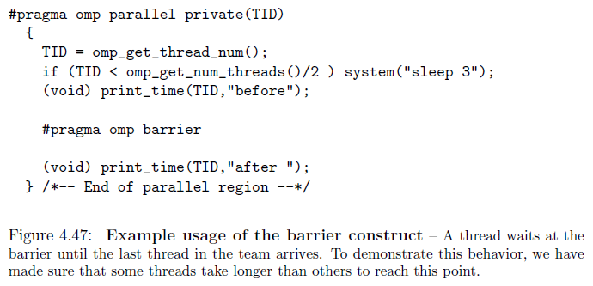
#pragma omp barrier

Slide 37
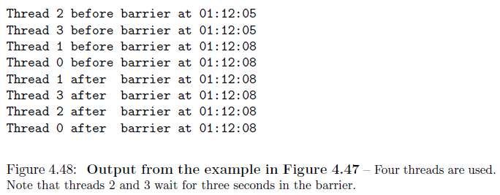
#pragma omp barrier
Threads 0 and 1 were delayed for 3 seconds, and threads 2 and 3 had to wait.

Slide 38
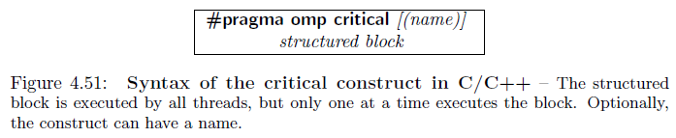
#pragma omp critical
The critical pragma indicates a block of code forming a critical section where mutual exclusion must be enforced.
The critical construct provides a means to ensure that multiple threads do not attempt to update the same shared data simultaneously. The associated code is referred to as a critical region, or a critical section.

Slide 39
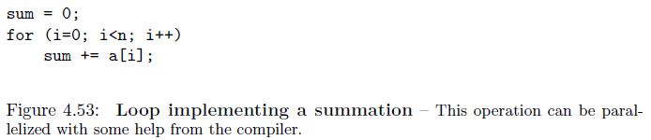
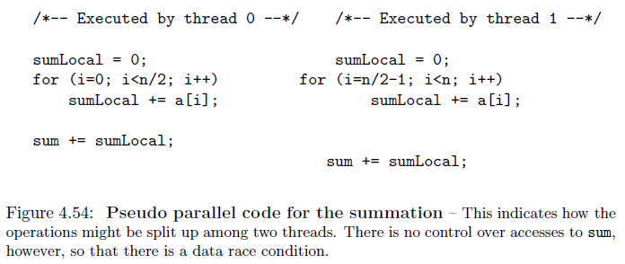
#pragma omp critical

Slide 40
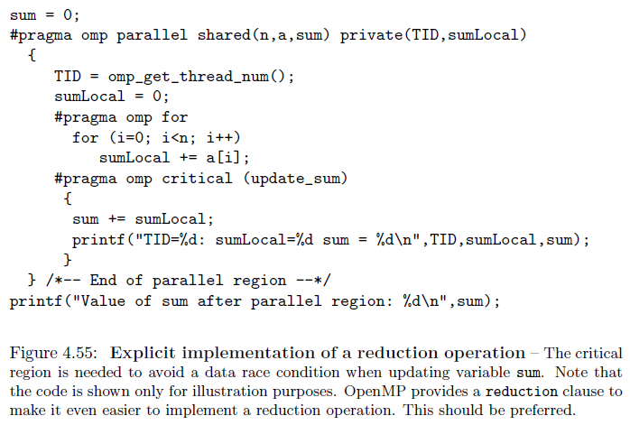
#pragma omp critical

Slide 41
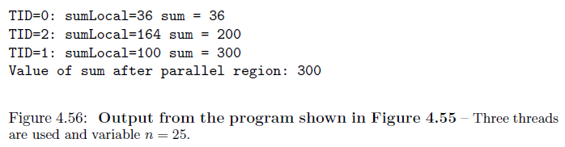
#pragma omp critical

Slide 42
omp_get_num_procs()
The function returns the number of physical processors available for use by the parallel program.
The function header:
int omp_get_num_procs(void)

Slide 43
omp_get_num_threads()
The function returns the number of active threads in parallel sections of code.

Slide 44
omp_set_num_threads()
The function uses the parameter value to set the number of threads to be active in parallel sections of code.
The function header:
void omp_set_num_threads(int t)
Example (#threads ← #processors):
int t;
t = omp_get_num_procs();
omp_set_num_threads(t);

Slide 45
omp_get_thread_num()
In OpenMP, every thread on a multiprocessor has a unique identification (ID) number. The ID number can be retrieved by using the function.
The function header:
int omp_get_thread_num(void)
If there are t active threads, the thread identification numbers are integers ranging from 0 through (t - 1). The master thread always has identification number 0.

Slide 46
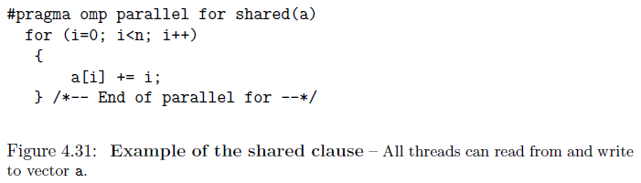
shared Clause
The shared clause is used to specify which data will be shared among the threads executing the region it is associated with.
Special care has to be taken to avoid race conditions.

Slide 47
private Clause
Syntax:
private(list)
Each variable in the list is replicated so that each thread in the team of threads has exclusive access to a local copy of this variable.
Values of private data are undefined upon entry to and exit from the specific construct.

Slide 48
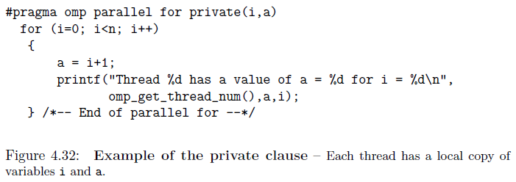
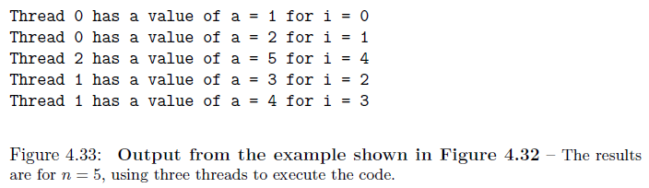
private Clause

Slide 49
firstprivate Clause
Variables that are declared to be firstprivate are private variables, but they are pre-initialized with the value of the variable with the same name before the construct.
The initialization is carried out by the initial thread priori to the execution of the construct.
Note that the values of the variables in the firstprivate list are initialized once per thread, not once per iteration.
If a thread executes multiple iterations of the parallel loop and modified the value of one of these variables in an iteration, then subsequent iterations referencing the variable will get the modified value, not the original value.

Slide 50
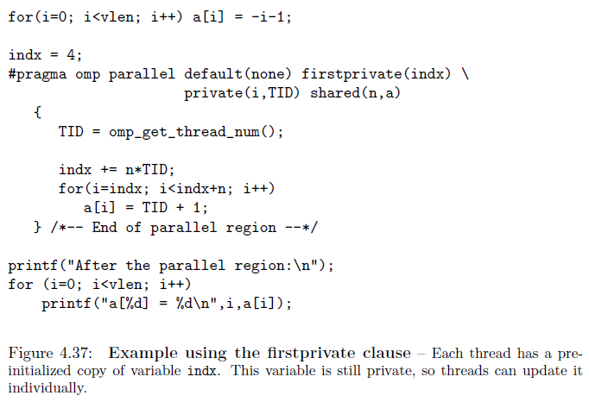
firstprivate Clause

Slide 51
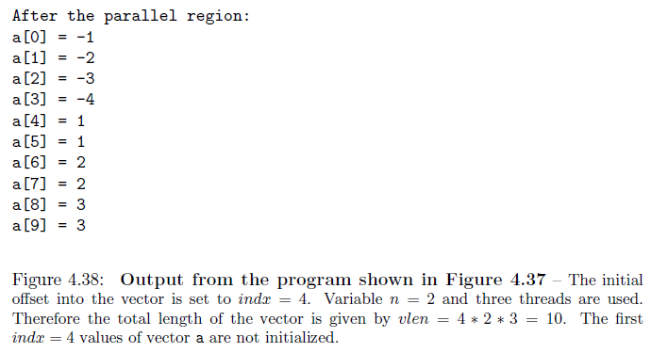
firstprivate Clause

Slide 52
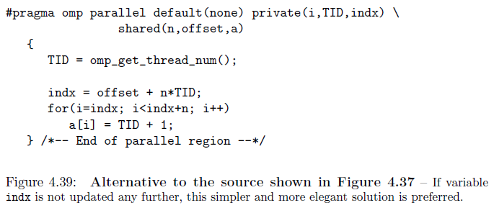
firstprivate Clause

Slide 53
firstprivate Clause
(omp_test08_2.c)
int main ()
{
int i, a;
#pragma omp parallel
{
a = 0;
#pragma omp for firstprivate(a)
for (i=0; i<10; i++)
{
a = a+i;
printf("i=%d, a=%d, thread_id=%d, #threads=%d \n",
i, a, omp_get_thread_num(), omp_get_num_threads() );
}
} /* All threads join master thread and terminate */
}

Slide 54
lastprivate Clause
The lastprivate clause ensures that the last value of a data object listed is accessible after the corresponding construct has completed execution.
In the case of the use with a work-shared loop, the last value of an object will have the value from the iteration of the loop that would be last in a sequential execution.
  See examples in Figures 4.34, 4.35, and 4.36
A performance penalty is likely to be associated with the use of lastprivate, because the OpenMP library needs to keep track of which thread executed the last iteration.

Slide 55
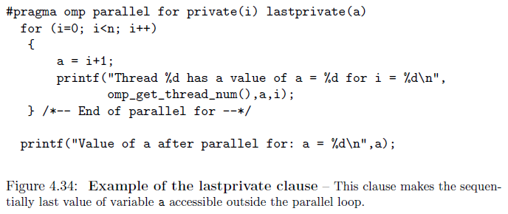
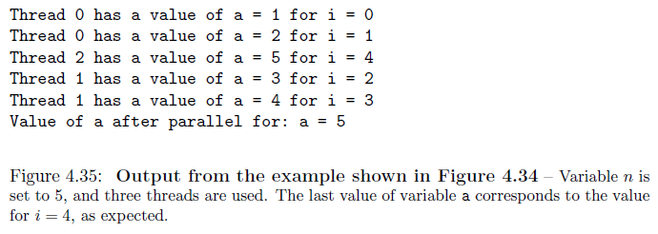
lastprivate Clause

Slide 56
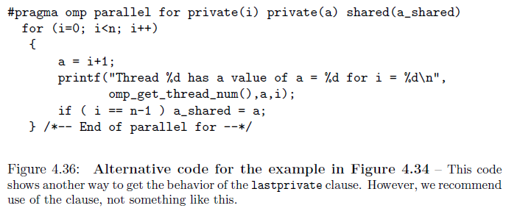
lastprivate Clause

Slide 57
firstprivate & lastprivate
A parallel for pragma may contain both firstprivate and lastprivate clauses. If the same pragma has both of these clauses, the clauses may have none, some, or all of the variables in common.

Slide 58
default Clause
Syntax:
default ( none | shared )
default(shared) assigns the shared attribute to all variables referenced in the construct. Only the exceptions need to be explicitly listed.
  #pragma omp for default(shared) private(a,b,c)
default(none): The programmer is forced to specify a data-sharing attribute (private or shared) for each variable in the construct.
default(private) is not supported in C/C++.

Slide 59
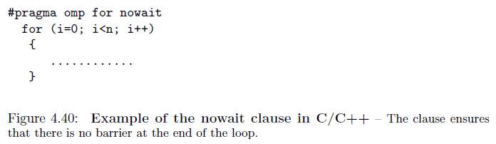
nowait Clause
The nowait clause suppresses the barrier at the end of the associated construct. When threads reach the end of the construct, they will immediately proceed to perform other work.
Note that the barrier at the end of a parallel region cannot be suppressed.
Some care is required because incorrect usage of the clause can introduce bugs.

Slide 60
if Clause
The if clause allows the system to determine at run-time if a construct should be executed sequentially or by multiple threads.
The if clause is supported on the parallel construct only.
If the logical expression evaluates to true, the parallel region will be executed by a team of threads. If it evaluates to false, the region is executed by a single thread only.

Slide 61
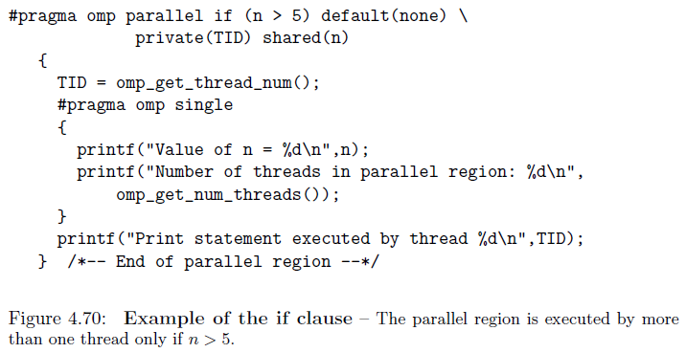
if Clause

Slide 62
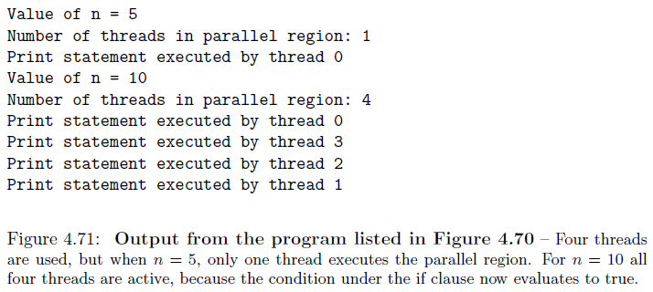
if Clause

Slide 63
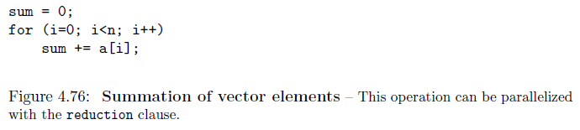
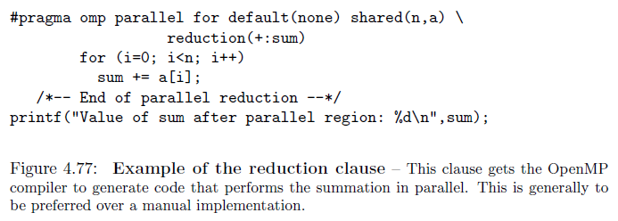
reduction Clause

Slide 64
reduction Clause
For the operator (“+”), the original value is updated with the new contribution, not overwritten.
The order in which thread-specific values are combined is unspecified. Therefore, where floating-point data are concerned, there may be numerical differences between the results of a sequential and parallel run, or even of two parallel runs using the same number of threads. This is a result of the limitation in precision with which computers represent floating-point numbers. It is good to keep this in mind when using the reduction clause.

Slide 65
schedule Clause
The schedule clause is supported on the loop constructs only.
The clause is used to control the manner in which loop iterations are distributed over the threads, which can have a major impact on the performance of a program.
The static schedule is more efficient than dynamic and guided clauses.
Both the dynamic and guided schedules are useful for handling poorly balanced and unpredictable workloads.
Example: “omp_test06.c”

Slide 66
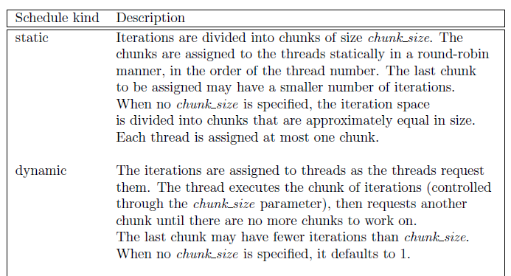
schedule Clause

Slide 67
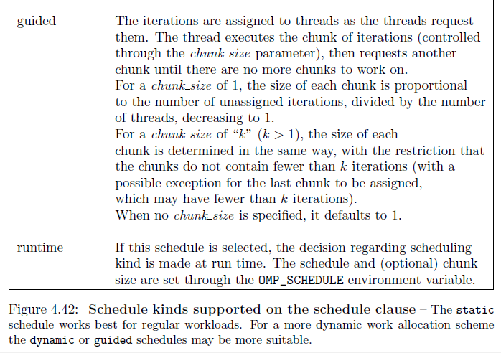
schedule Clause

Slide 68
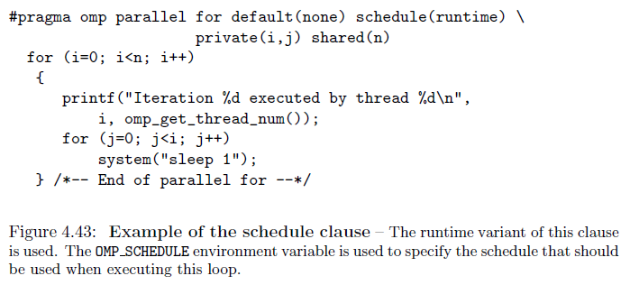
schedule Clause

Slide 69
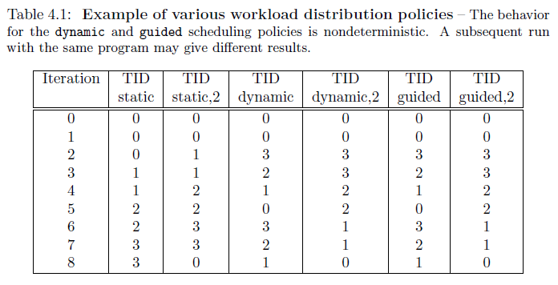
schedule Clause

Slide 70
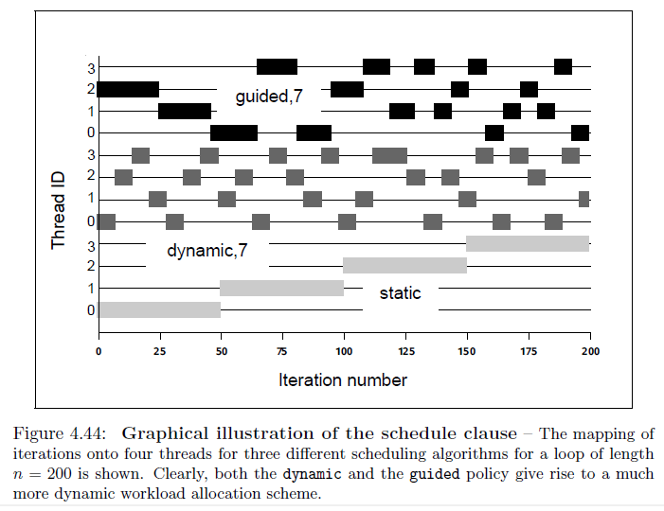
schedule Clause

Slide 71
Pragmas & Clauses
Pragma | Clauses allowed
critical | None
for | firstprivate, lastprivate, nowait, ordered, private, reduction, schedule
parallel | copyin, default, firstprivate, if, lastprivate, num_threads, private, reduction, shared
parallel for | firstprivate, if, lastprivate, private, reduction, schedule
parallel sections | firstprivate, if, lastprivate, private, reduction
sections | firstprivate, lastprivate, nowait, private, reduction
single | copyprivate, firstprivate, nowait, private

Slide 72
Comparison of OpenMP and MPI
Characteristic | OpenMP | MPI
Suitable for multiprocessors | Yes | Yes
Suitable for multicomputers | No | Yes
Supports incremental parallelization | Yes | No
Minimal extra code | Yes | No
Explicit control of memory hierarchy | No | Yes

