Slide 1
Performance Considerations for Using OpenMP
曾奕倫
Department of Computer Science & Engineering
Yuan Ze University

Slide 2
Textbooks
Barbara Chapman, Gabriele Jost, and Ruud van der Pas,
Using OpenMP – Portable Shared Memory Parallel Programming,
The MIT Press, 2008
  The book can be viewed on-line within .yzu.edu.tw domain: [Link]
Michael J. Quinn,
Parallel Programming in C with MPI and OpenMP,
McGraw Hill, 2003

Slide 3
Introduction
It may be possible to quickly write a correctly functioning OpenMP program, but not so easy to create a program that provides the desired level of performance.
Poor single-processor (“sequential”) performance is often caused by suboptimal usage of the cache memory subsystem found in contemporary computers.
A cache miss at the highest level in the cache hierarchy is expensive because it implies the data must be fetched from main memory before it can be used. If this situation happens frequently on a single-processor system, it can severely reduce program performance.

Slide 4
Introduction (cont’d)
On a shared-memory multiprocessor system, a miss at the highest cache level causes additional traffic on the system interconnect. No matter how fast this interconnect is, parallel performance degrades because none of the systems on the market today have an interconnect with sufficient bandwidth to sustain frequent cache misses simultaneously by all processors (or cores) in the system.

Slide 5
Multi-level Caches
A fundamental tradeoff between cache latency and hit rate:
  Larger caches have better hit rates but longer latency. To address this tradeoff, many computers use multiple levels of cache, with small fast caches backed up by larger slower caches.
  Multi-level caches generally operate by checking the smallest Level 1 (L1) cache first; if it hits, the processor proceeds at high speed. If the smaller cache misses, the next larger cache (L2) is checked, and so on, before external memory is checked.
(Source: http://en.wikipedia.org/wiki/CPU_cache)

Slide 6
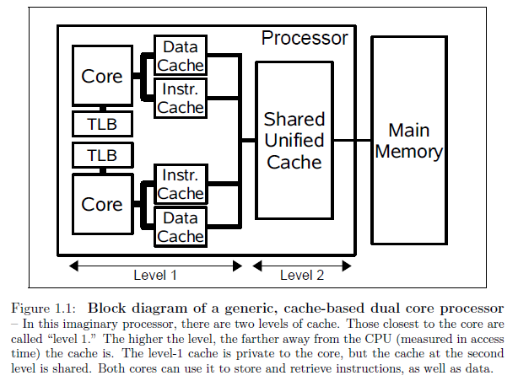
Block Diagram of a Dual-core CPU

Slide 7
Memory Access Patterns and Performance
A modern memory system is organized as a hierarchy:
  Main memory: the largest and the slowest
  The memory levels closer to the processor are smaller and faster and are known as cache.
If a value required for a computation is not already in a cache (we call this a cache miss), it must be retrieved from higher levels of the memory hierarchy (an expensive process).
The memory hierarchy is (with rare exceptions not explicitly) not explicitly programmable by either the user or the compiler. Rather, data are fetched into cache and evicted from it dynamically as the need arises.

Slide 8
Memory Access Patterns and Performance
(Arrays in C)
If an array element is fetched into cache, “nearby” elements of the array will be in the same cache block and will be fetched as part of the same transaction.
If a computation that uses any of these values can be performed while they are still in cache, it will be beneficial for performance.
In C, element [0][2] follows element [0][1], which follows element [0][0] in memory. Element [1][1] is followed by [1][2], and so forth.
When an array element is transferred to cache, neighbors in the same row are typically also transferred as part of the same cache line.

Slide 9
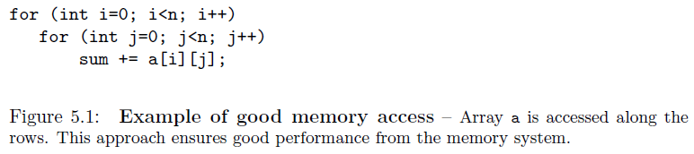
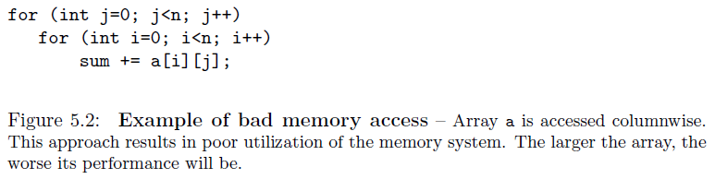
Example of Good and Bad Memory Access

Slide 10
Loop Optimizations
Loop Unrolling
Loop Fusion
Loop Fission
Loop Tiling (Loop Blocking)

Slide 11
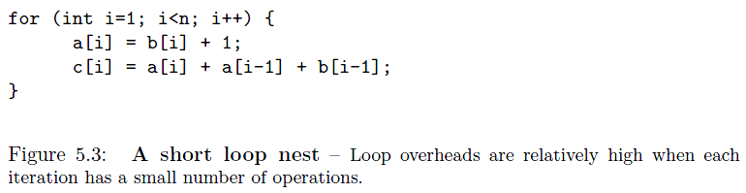
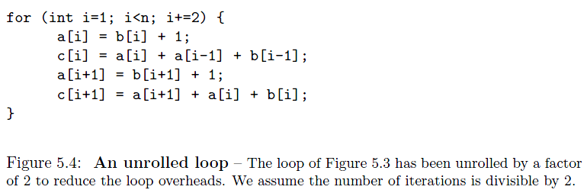
Loop Unrolling

Slide 12
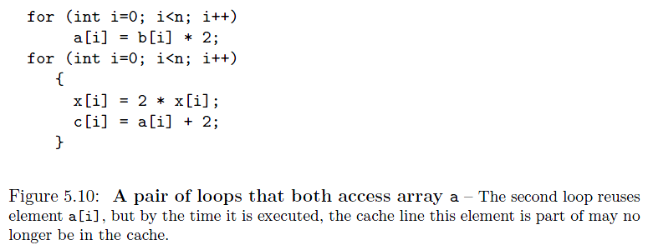
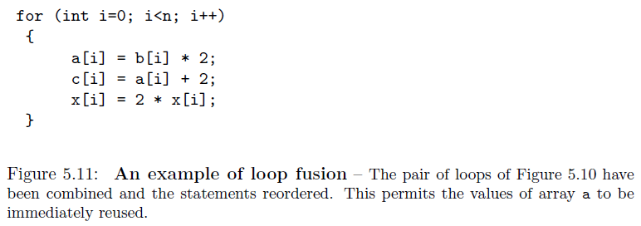
Loop Fusion

Slide 13
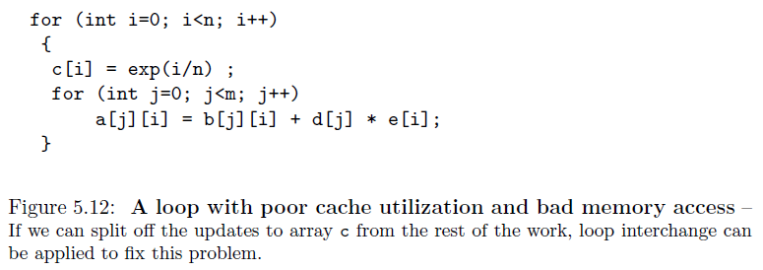
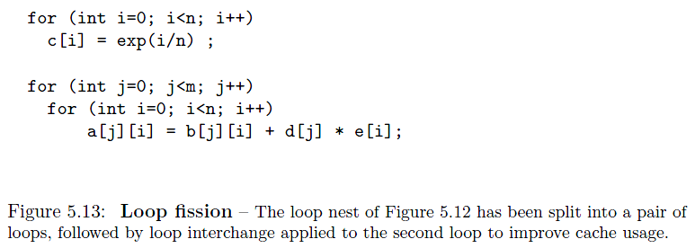
Loop Fission

Slide 14
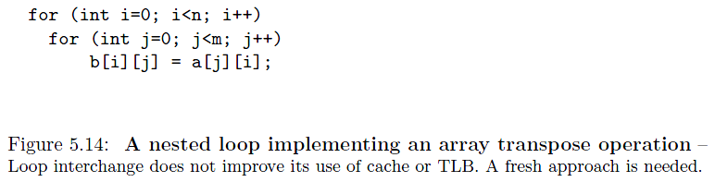
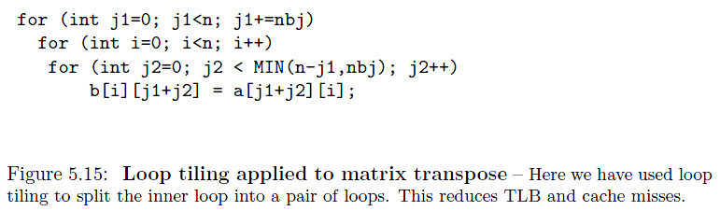
Loop Tiling (Loop Blocking)

Slide 15
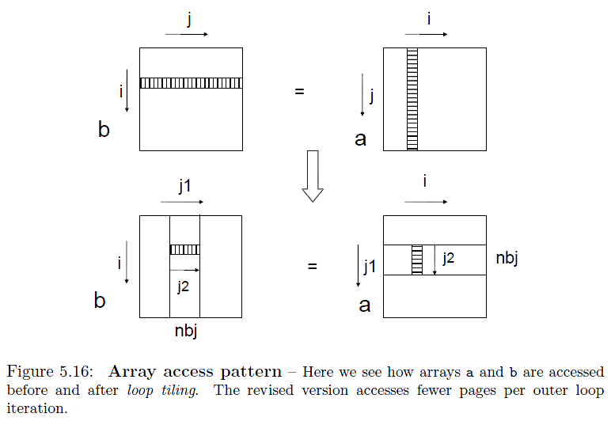
Loop Tiling (Loop Blocking)

Slide 16
Guidelines for Writing Efficient OpenMP Programs
Optimize Barrier Use
Avoid the Ordered Construct
Avoid Large Critical Regions
Maximize Parallel Regions
Avoid Parallel Regions in Inner Loops
Address Poor Load Balance

Slide 17
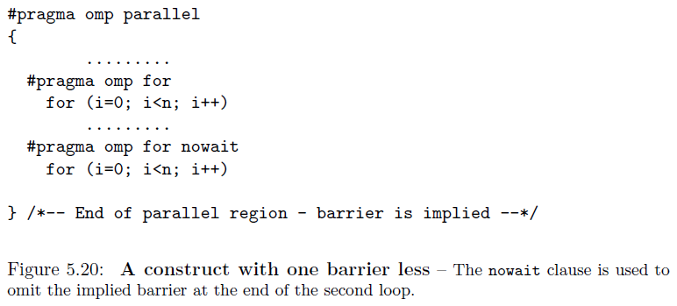
Optimize Barrier Use
Reduce the usage of barriers

Slide 18
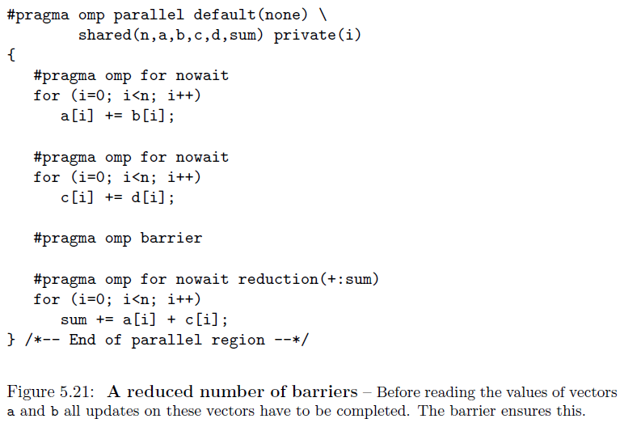
Optimize Barrier Use

Slide 19
Avoid the Ordered Construct
The ordered construct ensures that the corresponding block of code within a parallel loop is executed in the order of the loop iterations.
The ordered construct is expensive.

Slide 20
Avoid Large Critical Regions
A critical region is used to ensure that no two threads execute a piece of code simultaneously.
The programmer should minimize the amount of code enclosed within a critical region.
If a critical region is very large, program performance might be poor.
When the critical region contains a loop with some computation that requires exclusive access by a single thread at a time and some computation that does not ➔ Please consider rewrite the code.
An atomic update is usually preferred than a critical region.

Slide 21
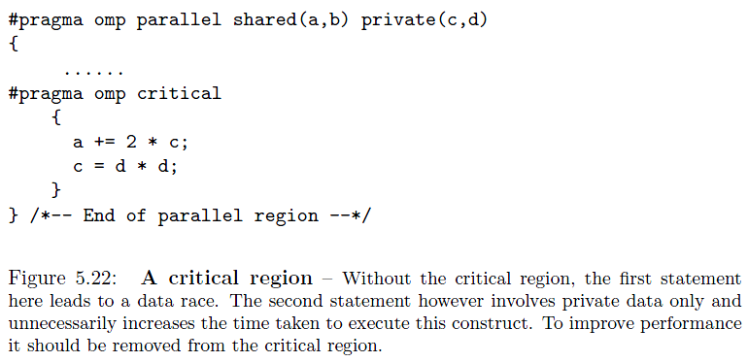
Avoid Large Critical Regions

Slide 22
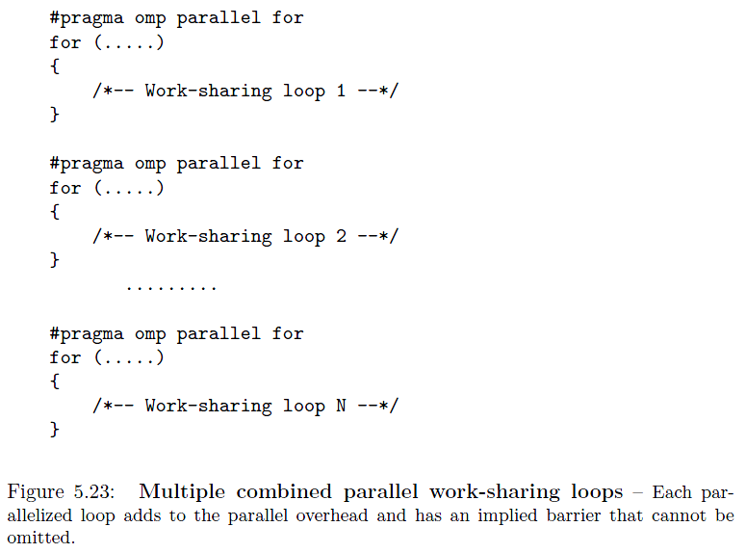
Maximize Parallel Regions

Slide 23
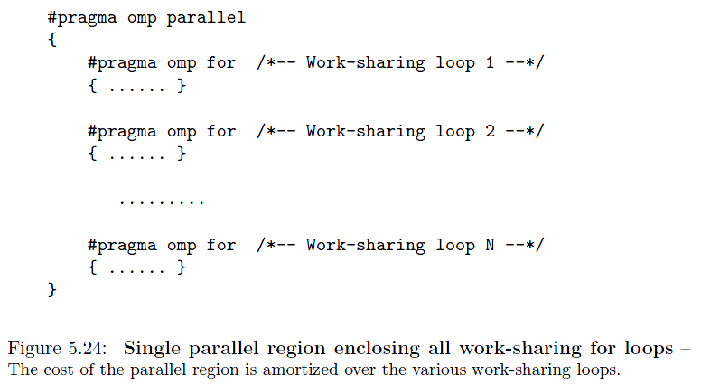
Maximize Parallel Regions

Slide 24
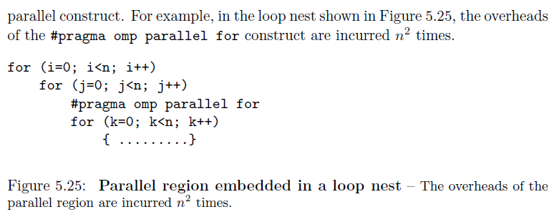
Avoid Parallel Regions in Inner Loops

Slide 25
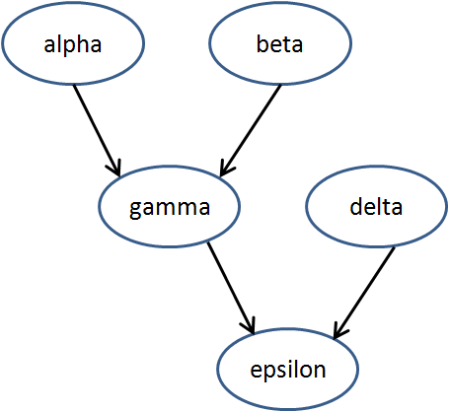
Address Poor Load Balance
v = alpha();
w = beta();
x = gamma(v, w);
y = delta();
printf(“%6.2f\n”,
epsilon(x,y));

Slide 26
Address Poor Load Balance
(Using the Sections Construct)
#pragma omp parallel sections
{
#pragma omp section
v = alpha();
#pragma omp section
w = beta();
#pragma omp section
y = delta();
}
x = gamma(v, w);
printf(“%6.2f\n”, epsilon(x,y));

Slide 27
Address Poor Load Balance
#pragma omp parallel
{
#pragma omp sections
{
#pragma omp section
v = alpha();
#pragma omp section
w = beta();
}
#pragma omp sections
{
#pragma omp section
x = gamma(v, w);
#pragma omp section
y = delta();
}
}
printf(“%6.2f\n”, epsilon(x,y));

Slide 28
Matrix Multiplication

Slide 29
Matrix Multiplication
Elements of the matrix C :

Slide 30
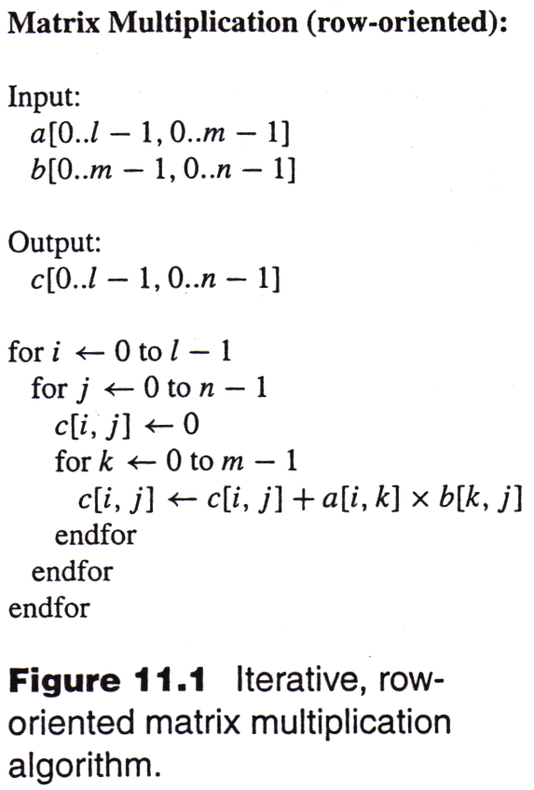
Sequential Matrix Multiplication

Slide 31
Sequential Matrix Multiplication
A sequential algorithm implementing matrix multiplication appears in Figure 11.1.
The algorithm requires lmn additions and the same number of multiplications.
The time complexity of multiplying two n x n matrices using this sequential algorithm is Θ(n³).

Slide 32
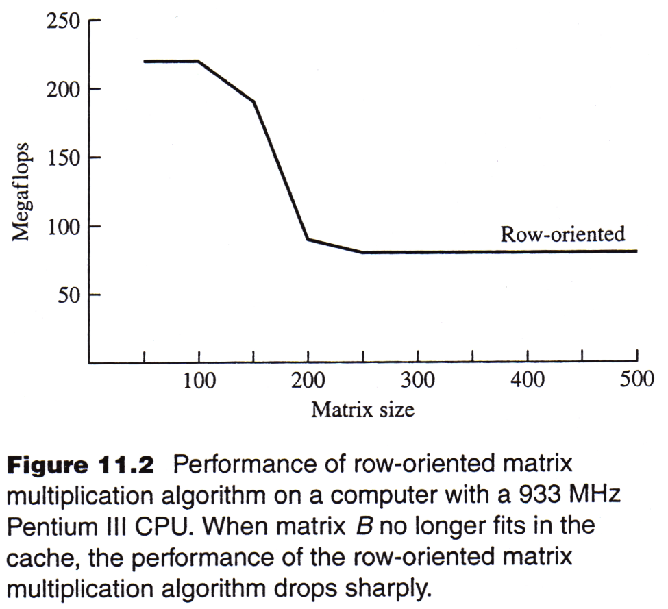
Sequential Matrix Multiplication
- Experimental Results

Slide 33
About the Experimental Results
FLOPS: FLoating point Operations Per Second
In Figure 11.2,
  For smaller matrices, the execution speed is about 220 megaflops.
  For larger matrices, the execution speed is about 80 megaflops.
  What accounts for this drop in performance?

Slide 34
Sequential Matrix Multiplication
During each iteration of the outer i loop, every element of matrix B is read. (Figure 11.3)
If matrix B is too large for the cache, then later elements read into cache displace earlier elements read into cache, meaning that in the next iteration of the loop indexed by i, all of the elements of B will need to be read into cache again.
Hence once the matrices reach a certain size, the cache hit rate falls dramatically, lowering the performance of the CPU.

Slide 35
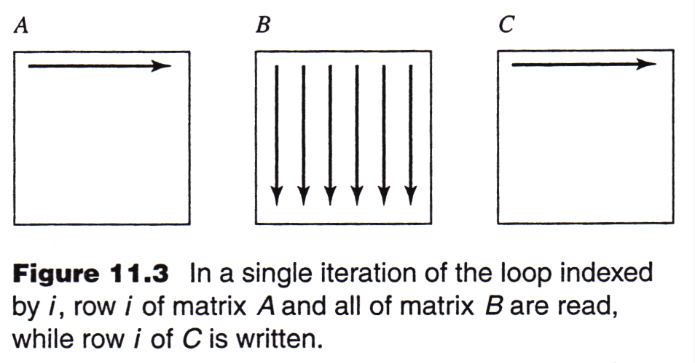
Sequential Matrix Multiplication

Slide 36
Sequential Matrix Multiplication
- About Experimental Results
The CPU used for benchmarking has a 256 KB cache
  256 KB = 256 x 1024 Bytes = 262,144 Bytes
We are multiplying double-precision floating-point numbers.
  each matrix element fills 8 Bytes.
Hence the cache can hold at most 32,768 matrix elements.
  262,144 / 8 = 32,768
The square root of 32,768 is about 181.
The performance of the algorithm reflects that when n <= 150, the cache hit rate is much higher than when n >= 200.

Slide 37
Sequential Matrix Multiplication
- Experimental Results

Slide 38
Recursive, Block-Oriented Algorithm
In order to perform the matrix multiplication AB, the number of columns of A must be equal to the number of rows of B.
Assume that A has l rows and m columns, while B has m rows and n columns.
If we divide A into four matrices, and divide B into four matrices:
such that the number of columns in A₀₀ and A₁₀ is equal to the number of rows in B₀₀ and B₀₁, then the matrix product:

Slide 39
Recursive, Block-Oriented Algorithm
(cont’d)
Our goal is to compute the matrix product C = AB.
If matrix B is too large to fit into cache, we can divide it into four pieces and use the idea of block matrix multiplication to compute C.
If block B_{i,j} is too large to fit into cache, we can apply this idea recursively until we have blocks that do fit into cache
See Figure 11.4 for the resulting recursive algorithm.
See Figure 11.5 for the illustration of how the algorithm works.
See Figure 11.6 for the experimental results.

Slide 40
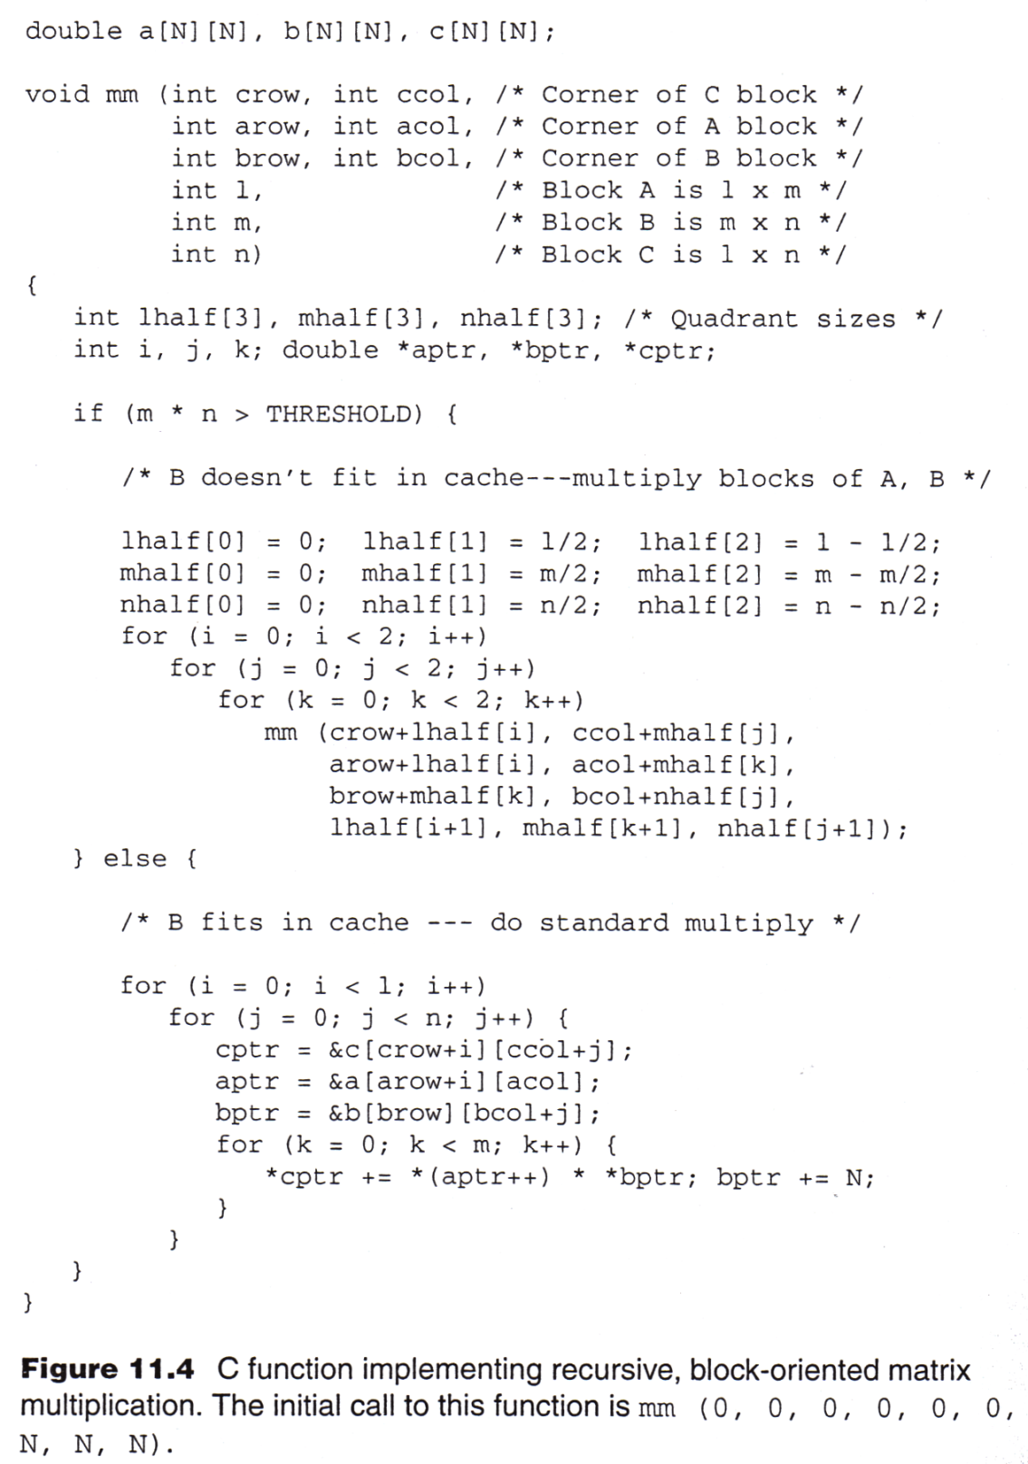

Slide 41
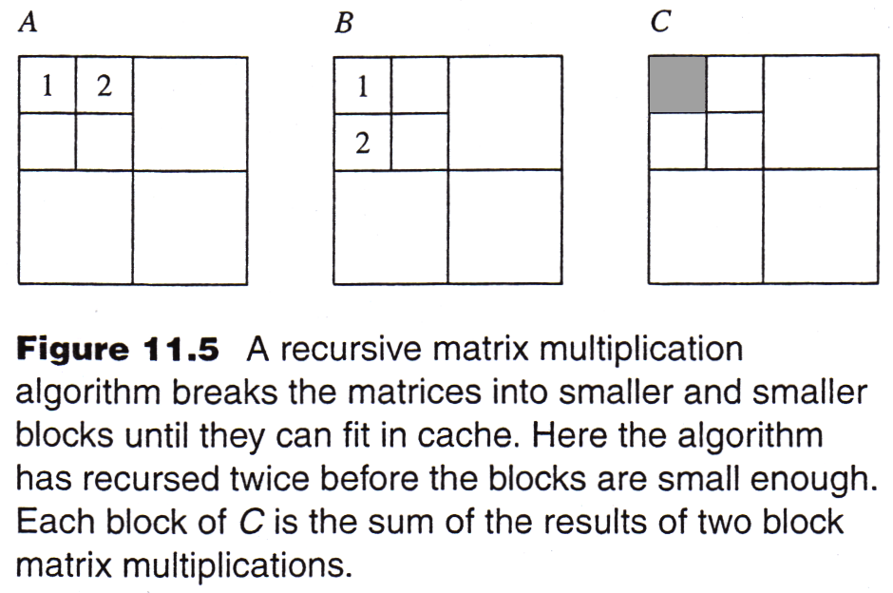
Recursive, Block-Oriented Algorithm

Slide 42
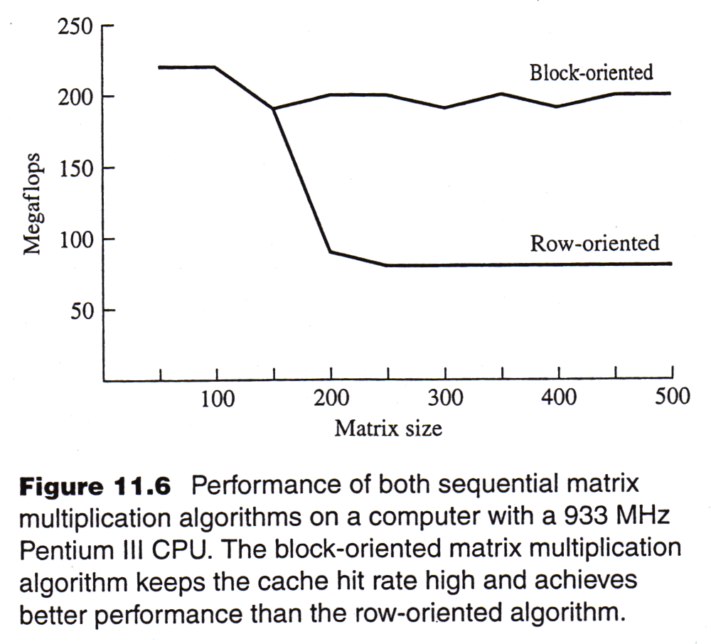
Recursive, Block-Oriented Algorithm
- Experimental Results

