Slide 1
Parallel Algorithms for VLSI Routing
曾奕倫
Department of Computer Science & Engineering
Yuan Ze University

Slide 2
Reference
Prithviraj Banerjee,
Parallel Algorithms for VLSI Computer-Aided Design,
Prentice-Hall, 1994
  Chapter 1: Introduction
  Chapter 2: Parallel Architectures and Programming
  Chapter 3: Placement and Floorplanning
  Chapter 4: Detailed and Global Routing
  Chapter 5: Layout Verification and Analysis
  Chapter 6: Circuit Simulation
  Chapter 7: Logic and Behavioral Simulation
  Chapter 8: Test Generation and Fault Simulation
  Chapter 9: Logic Synthesis and Verification
  Chapter 10: Conclusions and Future Directions

Slide 3
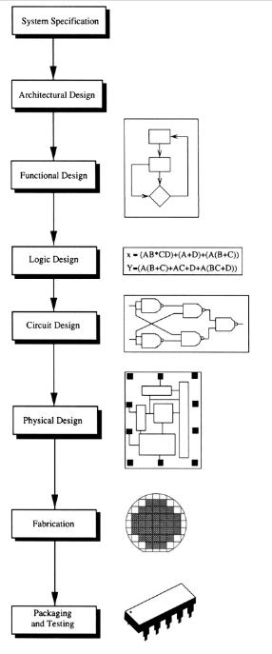
A Simple VLSI Design Flow
(Define: performance, process technology used, chip size, etc.)
(CISC/RISC, pipeline, number of ALUs, etc.) (Using SystemC)
(main functions of each unit, interconnects between units)
(Boolean expressions, using VHDL or Verilog)
(Logic gates, transistor-level)
(layout, physical layout, layout masks)
Tape-out
( TSMC, UMC)
Picture From: Naveed Sherwani, Algorithms for VLSI Physical Design Automation, 3rd edition, Springer, 1998
(封裝測試)

Slide 4
Introduction
VLSI Physical Design Automation
  Placement
  Routing
    Global Routing
    Detailed Routing
  Verification
    DRC (Design Rule Checking)
    Netlist Extraction
    LPE (Layout Parasitics Extraction) or PEX
    LVS (Layout versus Schematics)
    ERC (Electrical Rule Checking)

Slide 5
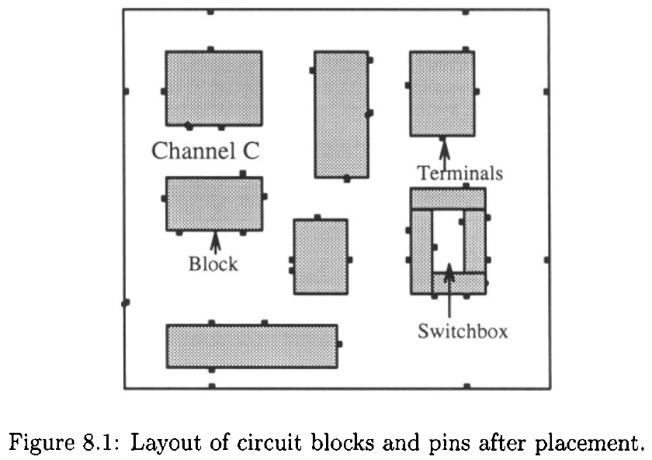
Layout After Placement

Slide 6
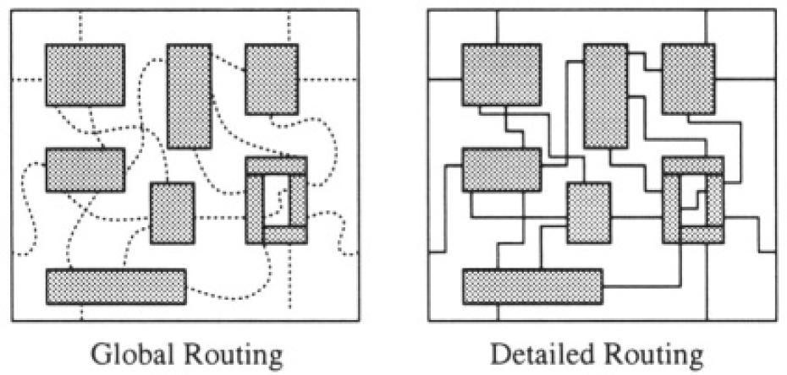
Global & Detailed Routing

Slide 7
Global Routing
Global Routing
  Steiner Tree Based Routing
  Iterative Improvement
  Graph Search Methods
  Maze Routing
  Layer Assignment

Slide 8
Detailed Routing
Detailed Routing
  General Purpose
    Maze routing
    Line search (Line expansion) routing
  Restricted
    Channel routing
    Switchbox routing

Slide 9
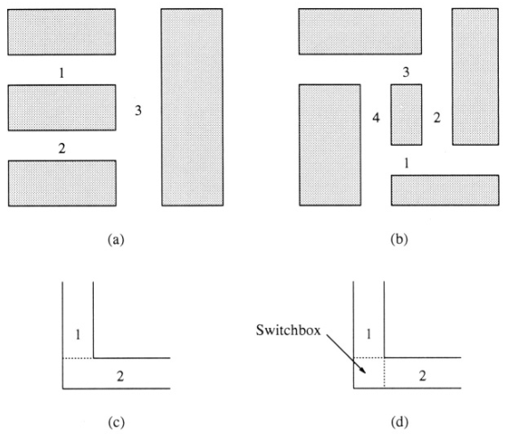
Channels & Switchboxes

Slide 10
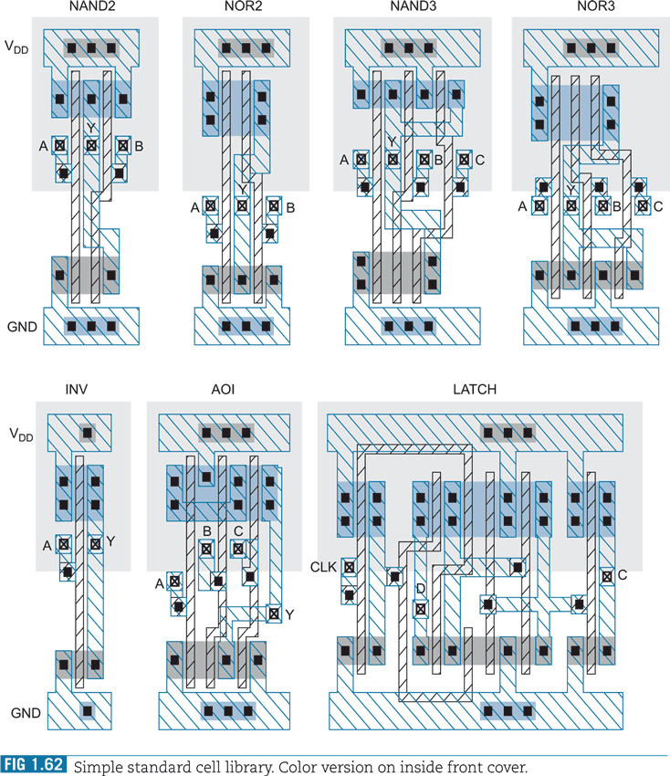
A Simple Standard Cell Library

Slide 11
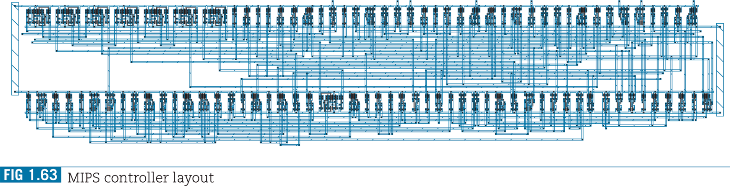
A Routing Example

Slide 12
Routing
Long wire lengths cause propagation delays, hence wire lengths have to be minimized.
Available routing space is often a variant, and hence overall area has to be minimized.
Nets carrying critical signals are often minimized at the expense of others.
Design rules need to be considered.
The number of vias need to be minimized.
Both placement and routing problems are NP-complete. Therefore, researchers have turned to parallel processing for solving these problems.

Slide 13
Maze Routing
Originally proposed by Lee and Moore
A net connects two pins at a time.
Maze Routing algorithms can be used to solve Detailed Routing and Global Routing problems.
Animations
  http://foghorn.cadlab.lafayette.edu/cadapplets/

Slide 14
The Lee’s (Lee-Moore) Algorithm
C. Y. Lee, “An Algorithm for Path Connections and Its Applications,” IRE Transactions on Electronic Computers, September 1961, pp. 346-365.
E . F. Moore, “The Shortest Path through a Maze,” Annals of the Computation Laboratory of Harvard University, 30, 1959, pp. 285-292.
Three phases
  Front wave expansion
  Path trace back phase
  Sweeping phase

Slide 15
A Maze Routing Problem
 |  |  |  |  | S
 |  |  | X | X | X | X
 |  |  |  |  |  | T
S: Source
T: Target

Slide 16
The Lee’s Algorithm
(1) Front Wave Expansion Phase
 |  |  |  |  | S
 |  |  | X | X | X | X
 |  |  |  |  |  | T

Slide 17
The Lee’s Algorithm
(1) Front Wave Expansion Phase
 |  |  |  |  | 1
 |  |  |  | 1 | S | 1
 |  |  | X | X | X | X
 |  |  |  |  |  | T

Slide 18
The Lee’s Algorithm
(1) Front Wave Expansion Phase
 |  |  |  |  | 2
 |  |  |  | 2 | 1 | 2
 |  |  | 2 | 1 | S | 1 | 2
 |  |  | X | X | X | X
 |  |  |  |  |  | T

Slide 19
The Lee’s Algorithm
(1) Front Wave Expansion Phase
 |  |  |  |  | 3
 |  |  |  | 3 | 2 | 3
 |  |  | 3 | 2 | 1 | 2 | 3
 |  | 3 | 2 | 1 | S | 1 | 2 | 3
 |  |  | X | X | X | X | 3
 |  |  |  |  |  | T

Slide 20
The Lee’s Algorithm
(1) Front Wave Expansion Phase
 |  |  |  |  | 4
 |  |  |  | 4 | 3 | 4
 |  |  | 4 | 3 | 2 | 3 | 4
 |  | 4 | 3 | 2 | 1 | 2 | 3 | 4
 | 4 | 3 | 2 | 1 | S | 1 | 2 | 3 | 4
 |  | 4 | X | X | X | X | 3 | 4
 |  |  |  |  |  | T | 4

Slide 21
The Lee’s Algorithm
(1) Front Wave Expansion Phase
 |  |  |  |  | 5
 |  |  |  | 5 | 4 | 5
 |  |  | 5 | 4 | 3 | 4 | 5
 |  | 5 | 4 | 3 | 2 | 3 | 4 | 5
 | 5 | 4 | 3 | 2 | 1 | 2 | 3 | 4 | 5
5 | 4 | 3 | 2 | 1 | S | 1 | 2 | 3 | 4 | 5
 | 5 | 4 | X | X | X | X | 3 | 4 | 5
 |  | 5 |  |  |  | T | 4 | 5
 |  |  |  |  |  |  | 5

Slide 22
The Lee’s Algorithm
(2) Path Trace Back Phase
 |  |  |  |  | 5
 |  |  |  | 5 | 4 | 5
 |  |  | 5 | 4 | 3 | 4 | 5
 |  | 5 | 4 | 3 | 2 | 3 | 4 | 5
 | 5 | 4 | 3 | 2 | 1 | 2 | 3 | 4 | 5
5 | 4 | 3 | 2 | 1 | S | 1 | 2 | 3 | 4 | 5
 | 5 | 4 | X | X | X | X | 3 | 4 | 5
 |  | 5 |  |  |  | T | 4 | 5
 |  |  |  |  |  |  | 5

Slide 23
The Lee’s Algorithm
(2) Path Trace Back Phase
 |  |  |  |  | 5
 |  |  |  | 5 | 4 | 5
 |  |  | 5 | 4 | 3 | 4 | 5
 |  | 5 | 4 | 3 | 2 | 3 | 4 | 5
 | 5 | 4 | 3 | 2 | 1 | 2 | 3 | 4 | 5
5 | 4 | 3 | 2 | 1 | S | 1 | 2 | 3 | 4 | 5
 | 5 | 4 | X | X | X | X | 3 | 4 | 5
 |  | 5 |  |  |  | T | 4 | 5
 |  |  |  |  |  |  | 5

Slide 24
The Lee’s Algorithm
(2) Path Trace Back Phase
 |  |  |  |  | 5
 |  |  |  | 5 | 4 | 5
 |  |  | 5 | 4 | 3 | 4 | 5
 |  | 5 | 4 | 3 | 2 | 3 | 4 | 5
 | 5 | 4 | 3 | 2 | 1 | 2 | 3 | 4 | 5
5 | 4 | 3 | 2 | 1 | S | 1 | 2 | 3 | 4 | 5
 | 5 | 4 | X | X | X | X | 3 | 4 | 5
 |  | 5 |  |  |  | T | 4 | 5
 |  |  |  |  |  |  | 5

Slide 25
The Lee’s Algorithm
(2) Path Trace Back Phase
 |  |  |  |  | 5
 |  |  |  | 5 | 4 | 5
 |  |  | 5 | 4 | 3 | 4 | 5
 |  | 5 | 4 | 3 | 2 | 3 | 4 | 5
 | 5 | 4 | 3 | 2 | 1 | 2 | 3 | 4 | 5
5 | 4 | 3 | 2 | 1 | S | 1 | 2 | 3 | 4 | 5
 | 5 | 4 | X | X | X | X | 3 | 4 | 5
 |  | 5 |  |  |  | T | 4 | 5
 |  |  |  |  |  |  | 5

Slide 26
The Lee’s Algorithm
(2) Path Trace Back Phase
 |  |  |  |  | 5
 |  |  |  | 5 | 4 | 5
 |  |  | 5 | 4 | 3 | 4 | 5
 |  | 5 | 4 | 3 | 2 | 3 | 4 | 5
 | 5 | 4 | 3 | 2 | 1 | 2 | 3 | 4 | 5
5 | 4 | 3 | 2 | 1 | S | 1 | 2 | 3 | 4 | 5
 | 5 | 4 | X | X | X | X | 3 | 4 | 5
 |  | 5 |  |  |  | T | 4 | 5
 |  |  |  |  |  |  | 5

Slide 27
The Lee’s Algorithm
(2) Path Trace Back Phase
 |  |  |  |  | 5
 |  |  |  | 5 | 4 | 5
 |  |  | 5 | 4 | 3 | 4 | 5
 |  | 5 | 4 | 3 | 2 | 3 | 4 | 5
 | 5 | 4 | 3 | 2 | 1 | 2 | 3 | 4 | 5
5 | 4 | 3 | 2 | 1 | S | 1 | 2 | 3 | 4 | 5
 | 5 | 4 | X | X | X | X | 3 | 4 | 5
 |  | 5 |  |  |  | T | 4 | 5
 |  |  |  |  |  |  | 5

Slide 28
The Lee’s Algorithm
(3) Sweeping Phase
 |  |  |  |  | 5
 |  |  |  | 5 | 4 | 5
 |  |  | 5 | 4 | 3 | 4 | 5
 |  | 5 | 4 | 3 | 2 | 3 | 4 | 5
 | 5 | 4 | 3 | 2 | 1 | 2 | 3 | 4 | 5
5 | 4 | 3 | 2 | 1 | S | 1 | 2 | 3 | 4 | 5
 | 5 | 4 | X | X | X | X | 3 | 4 | 5
 |  | 5 |  |  |  | T | 4 | 5
 |  |  |  |  |  |  | 5

Slide 29
The Lee’s Algorithm
(3) Sweeping Phase
 |  |  |  |  | 5
 |  |  |  | 5 | 4 | 5
 |  |  | 5 | 4 | 3 | 4 | 5
 |  | 5 | 4 | 3 | 2 | 3 | 4 | 5
 | 5 | 4 | 3 | 2 | 1 | 2 | 3 | 4 | 5
5 | 4 | 3 | 2 | 1 | X | X | X | 3 | 4 | 5
 | 5 | 4 | X | X | X | X | X | 4 | 5
 |  | 5 |  |  |  | X | X | 5
 |  |  |  |  |  |  | 5

Slide 30
The Lee’s Algorithm
(3) Sweeping Phase
 |  |  |  |  | X | X | X
 |  |  | X | X | X | X | X
 |  |  |  |  |  | X | X

Slide 31
The Lee’s Maze Routing Algorithm
Disadvantages
  Multiple-point nets need to be decomposed into two-point nets
  The quality of routing depends on the order in which the nets are routed
  Large memory requirements and long search times proportional to the square of the length of connections

Slide 32
Distributed-Memory Parallel Lee’s Algorithm
Y. Won and S. Sahni, “Maze Routing on a Hypercube Multiprocessor Computer,” Proc. Int. Conf. Parallel Processing, August 1987, pp. 630-637.
The basic idea is to partition the routing grid among the processors and have each processor participate in the different phases of the Lee’s algorithm.

Slide 33
Distributed-Memory Parallel Lee’s Algorithm
 |  |  |  |  | 5
 |  |  |  | 5 | 4 | 5
 |  |  | 5 | 4 | 3 | 4 | 5
 |  | 5 | 4 | 3 | 2 | 3 | 4 | 5
 | 5 | 4 | 3 | 2 | 1 | 2 | 3 | 4 | 5
5 | 4 | 3 | 2 | 1 | S | 1 | 2 | 3 | 4 | 5
 | 5 | 4 | X | X | X | X | 3 | 4 | 5
 |  | 5 |  |  |  | T | 4 | 5
 |  |  |  |  |  |  | 5

Slide 34
Grid Partitioning and Mapping to Processors
00
01
00
01
00
01
10
11
10
11
00
01
00
01
10
11
10
11
10
11
Two-dimensional blocked distribution
Two-dimensional cyclic distribution

Slide 35
Grid Partitioning and Mapping to Processors
2-D blocked distribution
  Lower communication cost between processors
2-D cyclic distribution:
  Better load balance (idle times of processors are reduced)

Slide 36
Shared Memory Parallel Lee’s Algorithm
The status of routing of the entire region is kept in global memory.
The n×n routing grid is partitioned into P square subregions (assuming P processors), and a task queue is assigned to each subregion that is associated with each processor.
A processor takes routing tasks off its own task queue, but can insert routing tasks into other processors’ task queues.
To prevent multiple processors accessing a task queue, locks are associated with the task queues.
A processor takes a task off its task queue and expands the wavefront.

Slide 37
Shared Memory Parallel Lee’s Algorithm (cont’d)
If the expanded cell is within the processor’s own subregion and the cell has not been labeled yet, it places the routing task for the cell on its own task queue.
If the expanded cell belongs to another processor’s subregion, it inserts the cell on the other processor’s task queue.
Insertion of the routing task on another processor’s task queue is done by locking and unlocking the appropriate task queue.

Slide 38
Line Search (Line Expansion) Routing
E
E
S
T
E

Slide 39
Line Search (Line Expansion) Routing
K. Mikami and K. Tabuchi, “A Computer Program for Optimal Routing of Printed Circuit Board Connections,” IFIPS Proc., H47, 1968, pp. 1475-1478.
David W. Hightower, “A Solution to Line-Routing Problems on the Continuous Plane,” Proceedings of Design Automation Conference, 1969, pp. 1-24.
The algorithm starts by determining the two points to be connected.
From each point, potential wiring segments are projected as far as possible in both the horizontal and vertical directions.
If the probes intersect, the routing is complete.
If the probes are stopped by some obstruction, the algorithm must choose a new escape point along the current probes from which additional probes are sent out.

Slide 40
Line Search Routing (cont’d)
The process of choosing escape points is the difference between the two original line search algorithms.
Mikami and Tabuchi’s algorithm is essentially a complete bread-first search and guarantees a solution if it exists. (Escape points for perpendicular lines at each grid intersection for each existing line segment)
Hightower’s algorithm tries to add only a single escape point to each line probe. Therefore, it may not produce a successful connection even if it exists.
Compared with Lee’s algorithms, line search routers have a major advantage in use of memory.

Slide 41
Watanabe’s Maze Routing Algorithm
Takumi Watanabe, Hitoshi Kitazawa, and Yoshi Sugiyama, “A Parallel Adaptable Routing Algorithm and its Implementation on a Two-Dimensional Array Processor,” IEEE Transactions on Computer-Aided Design of Integrated Circuits and Systems, Vol. CAD-6, No. 2, March 1987, pp. 241-250.
Parallel
PAR-1
  Similar to the Lee’s Algorithm
  Uses the expansion distance (D_{ex}) to control the quality of routing
PAR-2 (Double Front Wave Expansion)
  Requires the use of PAR-1
  Steiner tree construction

Slide 42
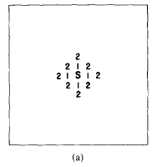
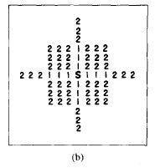
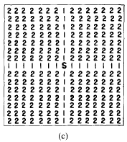
Watanabe’s PAR-1

Slide 43
Watanabe’s PAR-1
(D_{ex} = 4)
 |  |  |  |  |  |  |  |  |  |  | T
 |  |  | S

Slide 44
Watanabe’s PAR-1
(D_{ex} = 4)
 |  |  | 1 |  |  |  |  |  |  |  | T
 |  |  | 1
 |  |  | 1
 |  |  | 1
1 | 1 | 1 | S | 1
 |  |  | 1
 |  |  | 1
 |  |  | 1

Slide 45
Watanabe’s PAR-1
(D_{ex} = 4)
2 | 2 | 2 | 1 | 2 |  |  |  |  |  |  | T
2 | 2 | 2 | 1 | 2
2 | 2 | 2 | 1 | 2
2 | 2 | 2 | 1 | 2
1 | 1 | 1 | S | 1
2 | 2 | 2 | 1 | 2
 |  |  | 1 | 2 | 2 | 2 | 2
2 | 2 | 2 | 1 | 2 | 2 | 2 | 2

Slide 46
Watanabe’s PAR-1
(D_{ex} = 4)
3 | 3
3 | 3
3 | 3
3 | 3
2 | 2 | 2 | 1 | 2 |  |  |  |  |  |  | T
2 | 2 | 2 | 1 | 2
2 | 2 | 2 | 1 | 2
2 | 2 | 2 | 1 | 2 |  | 3 | 3
1 | 1 | 1 | S | 1 |  | 3 | 3
2 | 2 | 2 | 1 | 2 |  | 3 | 3
 |  |  | 1 | 2 | 2 | 2 | 2
2 | 2 | 2 | 1 | 2 | 2 | 2 | 2

Slide 47
Watanabe’s PAR-1
(D_{ex} = 4)
3 | 3 | 4 | 4 | 4 | 4
3 | 3 | 4 | 4 | 4 | 4
3 | 3 | 4
3 | 3
2 | 2 | 2 | 1 | 2 |  |  |  |  |  |  | T
2 | 2 | 2 | 1 | 2
2 | 2 | 2 | 1 | 2
2 | 2 | 2 | 1 | 2 |  | 3 | 3 | 4 | 4 | 4
1 | 1 | 1 | S | 1 |  | 3 | 3 | 4 | 4 | 4
2 | 2 | 2 | 1 | 2 |  | 3 | 3
 |  |  | 1 | 2 | 2 | 2 | 2
2 | 2 | 2 | 1 | 2 | 2 | 2 | 2

Slide 48
Watanabe’s PAR-1
(D_{ex} = 4)
 |  |  |  |  | 5
 |  |  |  |  | 5
 |  |  |  |  | 5
3 | 3 | 4 | 4 | 4 | 4 | 5 | 5
3 | 3 | 4 | 4 | 4 | 4 | 5 | 5
3 | 3 | 4 |  | 5 | 5
3 | 3
2 | 2 | 2 | 1 | 2 |  |  |  |  |  |  | T
2 | 2 | 2 | 1 | 2
2 | 2 | 2 | 1 | 2
2 | 2 | 2 | 1 | 2 |  | 3 | 3 | 4 | 4 | 4
1 | 1 | 1 | S | 1 |  | 3 | 3 | 4 | 4 | 4
2 | 2 | 2 | 1 | 2 |  | 3 | 3 |  | 5 | 5
 |  |  | 1 | 2 | 2 | 2 | 2 |  | 5 | 5
2 | 2 | 2 | 1 | 2 | 2 | 2 | 2 |  | 5 | 5

Slide 49
Watanabe’s PAR-1
(D_{ex} = 4)
 | 6 | 6 | 6 | 6 | 5
 | 6 | 6 | 6 | 6 | 5 | 6 | 6
 |  |  |  |  | 5 | 6 | 6
3 | 3 | 4 | 4 | 4 | 4 | 5 | 5
3 | 3 | 4 | 4 | 4 | 4 | 5 | 5
3 | 3 | 4 |  | 5 | 5 | 6 | 6
3 | 3 |  |  |  |  | 6 | 6
2 | 2 | 2 | 1 | 2 |  | 6 | 6 |  |  |  | T
2 | 2 | 2 | 1 | 2 |  | 6 | 6
2 | 2 | 2 | 1 | 2
2 | 2 | 2 | 1 | 2 |  | 3 | 3 | 4 | 4 | 4
1 | 1 | 1 | S | 1 |  | 3 | 3 | 4 | 4 | 4
2 | 2 | 2 | 1 | 2 |  | 3 | 3 |  | 5 | 5
 |  |  | 1 | 2 | 2 | 2 | 2 |  | 5 | 5 | 6 | 6 | 6 | 6
2 | 2 | 2 | 1 | 2 | 2 | 2 | 2 |  | 5 | 5 | 6 | 6 | 6 | 6

Slide 50
Watanabe’s PAR-1
(D_{ex} = 4)
7 | 6 | 6 | 6 | 6 | 5
7 | 6 | 6 | 6 | 6 | 5 | 6 | 6
 |  |  |  |  | 5 | 6 | 6
3 | 3 | 4 | 4 | 4 | 4 | 5 | 5
3 | 3 | 4 | 4 | 4 | 4 | 5 | 5
3 | 3 | 4 |  | 5 | 5 | 6 | 6
3 | 3 |  |  |  |  | 6 | 6 | 7 | 7 | 7 | 7
2 | 2 | 2 | 1 | 2 |  | 6 | 6 | 7 | 7 | 7 | T
2 | 2 | 2 | 1 | 2 |  | 6 | 6 | 7 | 7 | 7 | 7
2 | 2 | 2 | 1 | 2 |  |  |  |  |  |  |  |  |  | 7
2 | 2 | 2 | 1 | 2 |  | 3 | 3 | 4 | 4 | 4 |  |  |  | 7
1 | 1 | 1 | S | 1 |  | 3 | 3 | 4 | 4 | 4 |  | 7 | 7 | 7
2 | 2 | 2 | 1 | 2 |  | 3 | 3 |  | 5 | 5 |  | 7 | 7 | 7
 |  |  | 1 | 2 | 2 | 2 | 2 |  | 5 | 5 | 6 | 6 | 6 | 6
2 | 2 | 2 | 1 | 2 | 2 | 2 | 2 |  | 5 | 5 | 6 | 6 | 6 | 6

Slide 51
Watanabe’s PAR-1
(D_{ex} = 4)
 | 6 | 6 | 6 | 6 | 5
 | 6 | 6 | 6 | 6 | 5 | 6 | 6
 |  |  |  |  | 5 | 6 | 6
3 | 3 | 4 | 4 | 4 | 4 | 5 | 5
3 | 3 | 4 | 4 | 4 | 4 | 5 | 5
3 | 3 | 4 |  | 5 | 5 | 6 | 6
3 | 3 |  |  |  |  | 6 | 6
2 | 2 | 2 | 1 | 2 |  | 6 | 6 |  |  |  | T
2 | 2 | 2 | 1 | 2 |  | 6 | 6
2 | 2 | 2 | 1 | 2
2 | 2 | 2 | 1 | 2 |  | 3 | 3 | 4 | 4 | 4
1 | 1 | 1 | S | 1 |  | 3 | 3 | 4 | 4 | 4
2 | 2 | 2 | 1 | 2 |  | 3 | 3 |  | 5 | 5
 |  |  | 1 | 2 | 2 | 2 | 2 |  | 5 | 5 | 6 | 6 | 6 | 6
2 | 2 | 2 | 1 | 2 | 2 | 2 | 2 |  | 5 | 5 | 6 | 6 | 6 | 6

Slide 52
Watanabe’s PAR-1
(D_{ex} = 4)
 | 6 | 6 | 6 | 6 | 5
 | 6 | 6 | 6 | 6 | 5 | 6 | 6
 |  |  |  |  | 5 | 6 | 6
3 | 3 | 4 | 4 | 4 | 4 | 5 | 5
3 | 3 | 4 | 4 | 4 | 4 | 5 | 5
3 | 3 | 4 |  | 5 | 5 | 6 | 6
3 | 3 |  |  |  |  | 6 | 6
2 | 2 | 2 | 1 | 2 |  | 6 | 6 |  |  |  | T
2 | 2 | 2 | 1 | 2 |  | 6 | 6
2 | 2 | 2 | 1 | 2
2 | 2 | 2 | 1 | 2 |  | 3 | 3 | 4 | 4 | 4
1 | 1 | 1 | S | 1 |  | 3 | 3 | 4 | 4 | 4
2 | 2 | 2 | 1 | 2 |  | 3 | 3 |  | 5 | 5
 |  |  | 1 | 2 | 2 | 2 | 2 |  | 5 | 5 | 6 | 6 | 6 | 6
2 | 2 | 2 | 1 | 2 | 2 | 2 | 2 |  | 5 | 5 | 6 | 6 | 6 | 6

Slide 53
Watanabe’s PAR-1
(D_{ex} = 4)
 |  |  |  |  | 5
 |  |  |  |  | 5
 |  |  |  |  | 5
3 | 3 | 4 | 4 | 4 | 4 | 5 | 5
3 | 3 | 4 | 4 | 4 | 4 | 5 | 5
3 | 3 | 4 |  | 5 | 5
3 | 3
2 | 2 | 2 | 1 | 2 |  |  |  |  |  |  | T
2 | 2 | 2 | 1 | 2
2 | 2 | 2 | 1 | 2
2 | 2 | 2 | 1 | 2 |  | 3 | 3 | 4 | 4 | 4
1 | 1 | 1 | S | 1 |  | 3 | 3 | 4 | 4 | 4
2 | 2 | 2 | 1 | 2 |  | 3 | 3 |  | 5 | 5
 |  |  | 1 | 2 | 2 | 2 | 2 |  | 5 | 5
2 | 2 | 2 | 1 | 2 | 2 | 2 | 2 |  | 5 | 5

Slide 54
Watanabe’s PAR-1
(D_{ex} = 4)
 |  |  |  |  | 5
 |  |  |  |  | 5
 |  |  |  |  | 5
3 | 3 | 4 | 4 | 4 | 4 | 5 | 5
3 | 3 | 4 | 4 | 4 | 4 | 5 | 5
3 | 3 | 4 |  | 5 | 5
3 | 3
2 | 2 | 2 | 1 | 2 |  |  |  |  |  |  | T
2 | 2 | 2 | 1 | 2
2 | 2 | 2 | 1 | 2
2 | 2 | 2 | 1 | 2 |  | 3 | 3 | 4 | 4 | 4
1 | 1 | 1 | S | 1 |  | 3 | 3 | 4 | 4 | 4
2 | 2 | 2 | 1 | 2 |  | 3 | 3 |  | 5 | 5
 |  |  | 1 | 2 | 2 | 2 | 2 |  | 5 | 5
2 | 2 | 2 | 1 | 2 | 2 | 2 | 2 |  | 5 | 5

Slide 55
Watanabe’s PAR-1
(D_{ex} = 4)
3 | 3 | 4 | 4 | 4 | 4
3 | 3 | 4 | 4 | 4 | 4
3 | 3 | 4
3 | 3
2 | 2 | 2 | 1 | 2 |  |  |  |  |  |  | T
2 | 2 | 2 | 1 | 2
2 | 2 | 2 | 1 | 2
2 | 2 | 2 | 1 | 2 |  | 3 | 3 | 4 | 4 | 4
1 | 1 | 1 | S | 1 |  | 3 | 3 | 4 | 4 | 4
2 | 2 | 2 | 1 | 2 |  | 3 | 3
 |  |  | 1 | 2 | 2 | 2 | 2
2 | 2 | 2 | 1 | 2 | 2 | 2 | 2

Slide 56
Watanabe’s PAR-1
(D_{ex} = 4)
3 | 3 | 4 | 4 | 4 | 4
3 | 3 | 4 | 4 | 4 | 4
3 | 3 | 4
3 | 3
2 | 2 | 2 | 1 | 2 |  |  |  |  |  |  | T
2 | 2 | 2 | 1 | 2
2 | 2 | 2 | 1 | 2
2 | 2 | 2 | 1 | 2 |  | 3 | 3 | 4 | 4 | 4
1 | 1 | 1 | S | 1 |  | 3 | 3 | 4 | 4 | 4
2 | 2 | 2 | 1 | 2 |  | 3 | 3
 |  |  | 1 | 2 | 2 | 2 | 2
2 | 2 | 2 | 1 | 2 | 2 | 2 | 2

Slide 57
Watanabe’s PAR-1
(D_{ex} = 4)
3 | 3
3 | 3
3 | 3
3 | 3
2 | 2 | 2 | 1 | 2 |  |  |  |  |  |  | T
2 | 2 | 2 | 1 | 2
2 | 2 | 2 | 1 | 2
2 | 2 | 2 | 1 | 2 |  | 3 | 3
1 | 1 | 1 | S | 1 |  | 3 | 3
2 | 2 | 2 | 1 | 2 |  | 3 | 3
 |  |  | 1 | 2 | 2 | 2 | 2
2 | 2 | 2 | 1 | 2 | 2 | 2 | 2

Slide 58
Watanabe’s PAR-1
(D_{ex} = 4)
3 | 3
3 | 3
3 | 3
3 | 3
2 | 2 | 2 | 1 | 2 |  |  |  |  |  |  | T
2 | 2 | 2 | 1 | 2
2 | 2 | 2 | 1 | 2
2 | 2 | 2 | 1 | 2 |  | 3 | 3
1 | 1 | 1 | S | 1 |  | 3 | 3
2 | 2 | 2 | 1 | 2 |  | 3 | 3
 |  |  | 1 | 2 | 2 | 2 | 2
2 | 2 | 2 | 1 | 2 | 2 | 2 | 2

Slide 59
Watanabe’s PAR-1
(D_{ex} = 4)
2 | 2 | 2 | 1 | 2 |  |  |  |  |  |  | T
2 | 2 | 2 | 1 | 2
2 | 2 | 2 | 1 | 2
2 | 2 | 2 | 1 | 2
1 | 1 | 1 | S | 1
2 | 2 | 2 | 1 | 2
 |  |  | 1 | 2 | 2 | 2 | 2
2 | 2 | 2 | 1 | 2 | 2 | 2 | 2

Slide 60
Watanabe’s PAR-1
(D_{ex} = 4)
2 | 2 | 2 | 1 | 2 |  |  |  |  |  |  | T
2 | 2 | 2 | 1 | 2
2 | 2 | 2 | 1 | 2
2 | 2 | 2 | 1 | 2
1 | 1 | 1 | S | 1
2 | 2 | 2 | 1 | 2
 |  |  | 1 | 2 | 2 | 2 | 2
2 | 2 | 2 | 1 | 2 | 2 | 2 | 2

Slide 61
Watanabe’s PAR-1
(D_{ex} = 4)
 |  |  | 1 |  |  |  |  |  |  |  | T
 |  |  | 1
 |  |  | 1
 |  |  | 1
1 | 1 | 1 | S | 1
 |  |  | 1
 |  |  | 1
 |  |  | 1

Slide 62
Watanabe’s PAR-1
(D_{ex} = 4)
 |  |  | 1 |  |  |  |  |  |  |  | T
 |  |  | 1
 |  |  | 1
 |  |  | 1
1 | 1 | 1 | S | 1
 |  |  | 1
 |  |  | 1
 |  |  | 1

Slide 63
Watanabe’s PAR-1
(D_{ex} = 4)
 |  |  |  |  |  |  |  |  |  |  | T
 |  |  | S

Slide 64
Watanabe’s PAR-1
(D_{ex} = 4)
 |  |  |  |  |  |  |  |  |  |  | T
 |  |  | S

Slide 65
Watanabe’s PAR-1
When D_{ex} = 1, PAR-1 equals the Lee’s algorithm.
  Shortest path
When D_{ex} = ∞, PAR-1 becomes a line search (or line expansion) algorithm.
  Minimize the number of vias

Slide 66
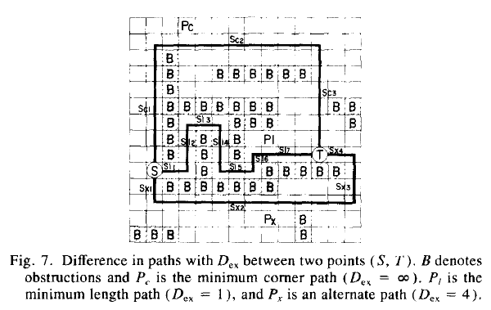
Watanabe’s PAR-1

Slide 67
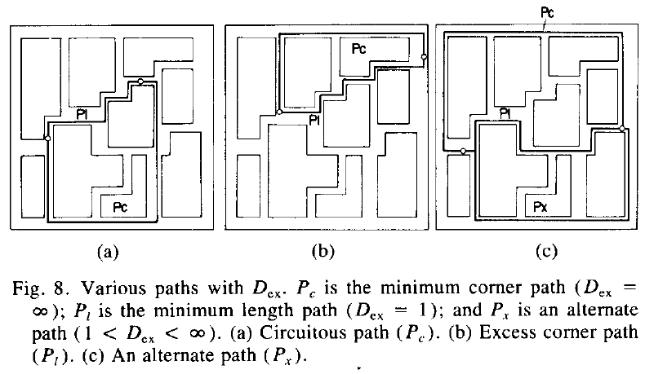
Watanabe’s PAR-1

Slide 68
Watanabe’s PAR-2
Steiner Tree Construction
Can be used to connect multiple-pin nets
Double Wave Expansion
  1st wave expansion
  2nd wave expansion

Slide 69
Watanabe’s PAR-2
(1st Wave Expansion)
 | T₁
 |  |  |  |  |  |  |  | T₃
 |  |  |  | T₂

Slide 70
Watanabe’s PAR-2
(1st Wave Expansion)
 | 1
1 | T₁ | 1
 | 1
 |  |  |  |  |  |  |  | T₃
 |  |  |  | T₂

Slide 71
Watanabe’s PAR-2
(1st Wave Expansion)
2 | 1 | 2
1 | T₁ | 1 | 2
2 | 1 | 2
 | 2
 |  |  |  |  |  |  |  | T₃
 |  |  |  | T₂

Slide 72
Watanabe’s PAR-2
(1st Wave Expansion)
2 | 1 | 2 | 3
1 | T₁ | 1 | 2
2 | 1 | 2 | 3
3 | 2 | 3
 | 3
 |  |  |  |  |  |  |  | T₃
 |  |  |  | T₂

Slide 73
Watanabe’s PAR-2
(1st Wave Expansion)
2 | 1 | 2 | 3 | 4
1 | T₁ | 1 | 2
2 | 1 | 2 | 3
3 | 2 | 3 | 4
4 | 3 | 4
 | 4 |  |  |  |  |  |  | T₃
 |  |  |  | T₂

Slide 74
Watanabe’s PAR-2
(1st Wave Expansion)
2 | 1 | 2 | 3 | 4 | 5
1 | T₁ | 1 | 2
2 | 1 | 2 | 3
3 | 2 | 3 | 4
4 | 3 | 4 | 5
5 | 4 | 5 |  |  |  |  |  | T₃
 | 5
 |  |  |  | T₂

Slide 75
Watanabe’s PAR-2
(1st Wave Expansion)
2 | 1 | 2 | 3 | 4 | 5 | 6
1 | T₁ | 1 | 2
2 | 1 | 2 | 3
3 | 2 | 3 | 4
4 | 3 | 4 | 5 | 6
5 | 4 | 5 | 6 |  |  |  |  | T₃
6 | 5 | 6
 | 6
 |  |  |  | T₂

Slide 76
Watanabe’s PAR-2
(1st Wave Expansion)
2 | 1 | 2 | 3 | 4 | 5 | 6 | 7
1 | T₁ | 1 | 2
2 | 1 | 2 | 3
3 | 2 | 3 | 4
4 | 3 | 4 | 5 | 6 | 7
5 | 4 | 5 | 6 | 7 |  |  |  | T₃
6 | 5 | 6 | 7
7 | 6 | 7
 | 7 |  |  | T₂

Slide 77
Watanabe’s PAR-2
(1st Wave Expansion)
2 | 1 | 2 | 3 | 4 | 5 | 6 | 7 | 8
1 | T₁ | 1 | 2
2 | 1 | 2 | 3
3 | 2 | 3 | 4
4 | 3 | 4 | 5 | 6 | 7 | 8
5 | 4 | 5 | 6 | 7 | 8 |  |  | T₃
6 | 5 | 6 | 7 | 8
7 | 6 | 7 | 8
8 | 7 | 8 |  | T₂
 | 8

Slide 78
Watanabe’s PAR-2
(1st Wave Expansion)
2 | 1 | 2 | 3 | 4 | 5 | 6 | 7 | 8 | 9
1 | T₁ | 1 | 2
2 | 1 | 2 | 3
3 | 2 | 3 | 4
4 | 3 | 4 | 5 | 6 | 7 | 8 | 9
5 | 4 | 5 | 6 | 7 | 8 | 9 |  | T₃
6 | 5 | 6 | 7 | 8 | 9
7 | 6 | 7 | 8 | 9
8 | 7 | 8 | 9 | T₂
9 | 8 | 9

Slide 79
Watanabe’s PAR-2
(1st Wave Expansion)
2 | 1 | 2 | 3 | 4 | 5 | 6 | 7 | 8 | 9
1 | T₁ | 1 | 2 |  |  |  |  |  | 10
2 | 1 | 2 | 3
3 | 2 | 3 | 4
4 | 3 | 4 | 5 | 6 | 7 | 8 | 9 | 10
5 | 4 | 5 | 6 | 7 | 8 | 9 | 10 | T₃
6 | 5 | 6 | 7 | 8 | 9 | 10
7 | 6 | 7 | 8 | 9 | 10
8 | 7 | 8 | 9 | T₂
9 | 8 | 9 | 10

Slide 80
Watanabe’s PAR-2
(2nd Wave Expansion)
 | T₁
 |  |  |  |  |  |  |  | T₃
 |  |  |  | T₂

Slide 81
Watanabe’s PAR-2
(2nd Wave Expansion)
 | T₁
 |  |  |  |  |  |  |  | T₃
 |  |  |  | 9
 |  |  | 9 | T₂ | 9
 |  |  |  | 9

Slide 82
Watanabe’s PAR-2
(2nd Wave Expansion)
 | T₁
 |  |  |  |  |  |  |  | T₃
 |  |  |  | 8
 |  |  | 8 | 9 | 8
 |  | 8 | 9 | T₂ | 9 | 8
 |  |  | 8 | 9 | 8

Slide 83
Watanabe’s PAR-2
(2nd Wave Expansion)
 | T₁
 |  |  |  | 7 |  |  |  | T₃
 |  |  | 7 | 8 | 7
 |  | 7 | 8 | 9 | 8 | 7
 | 7 | 8 | 9 | T₂ | 9 | 8 | 7
 |  | 7 | 8 | 9 | 8 | 7

Slide 84
Watanabe’s PAR-2
(2nd Wave Expansion)
 | T₁
 |  |  |  | 6
 |  |  | 6 | 7 | 6 |  |  | T₃
 |  | 6 | 7 | 8 | 7 | 6
 | 6 | 7 | 8 | 9 | 8 | 7 | 6
6 | 7 | 8 | 9 | T₂ | 9 | 8 | 7 | 6
 | 6 | 7 | 8 | 9 | 8 | 7 | 6

Slide 85
Watanabe’s PAR-2
(2nd Wave Expansion)
 | T₁
 |  |  | 5 | 6 | 5
 |  | 5 | 6 | 7 | 6 | 5 |  | T₃
 | 5 | 6 | 7 | 8 | 7 | 6 | 5
5 | 6 | 7 | 8 | 9 | 8 | 7 | 6 | 5
6 | 7 | 8 | 9 | T₂ | 9 | 8 | 7 | 6 | 5
5 | 6 | 7 | 8 | 9 | 8 | 7 | 6 | 5

Slide 86
Watanabe’s PAR-2
(2nd Wave Expansion)
 | T₁
 |  |  | 4
 |  | 4 | 5 | 6 | 5 | 4
 | 4 | 5 | 6 | 7 | 6 | 5 | 4 | T₃
4 | 5 | 6 | 7 | 8 | 7 | 6 | 5 | 4
5 | 6 | 7 | 8 | 9 | 8 | 7 | 6 | 5 | 4
6 | 7 | 8 | 9 | T₂ | 9 | 8 | 7 | 6 | 5
5 | 6 | 7 | 8 | 9 | 8 | 7 | 6 | 5 | 4

Slide 87
Watanabe’s PAR-2
(2nd Wave Expansion)
 | T₁
 |  |  | 3
 |  | 3 | 4
 | 3 | 4 | 5 | 6 | 5 | 4 | 3
3 | 4 | 5 | 6 | 7 | 6 | 5 | 4 | T₃
4 | 5 | 6 | 7 | 8 | 7 | 6 | 5 | 4 | 3
5 | 6 | 7 | 8 | 9 | 8 | 7 | 6 | 5 | 4
6 | 7 | 8 | 9 | T₂ | 9 | 8 | 7 | 6 | 5
5 | 6 | 7 | 8 | 9 | 8 | 7 | 6 | 5 | 4

Slide 88
Watanabe’s PAR-2
(2nd Wave Expansion)
 | T₁ |  | 2
 |  | 2 | 3
 | 2 | 3 | 4
2 | 3 | 4 | 5 | 6 | 5 | 4 | 3 | 2
3 | 4 | 5 | 6 | 7 | 6 | 5 | 4 | T₃ | 2
4 | 5 | 6 | 7 | 8 | 7 | 6 | 5 | 4 | 3
5 | 6 | 7 | 8 | 9 | 8 | 7 | 6 | 5 | 4
6 | 7 | 8 | 9 | T₂ | 9 | 8 | 7 | 6 | 5
5 | 6 | 7 | 8 | 9 | 8 | 7 | 6 | 5 | 4

Slide 89
Watanabe’s PAR-2
(2nd Wave Expansion)
 |  |  | 1
 | T₁ | 1 | 2
 | 1 | 2 | 3
1 | 2 | 3 | 4
2 | 3 | 4 | 5 | 6 | 5 | 4 | 3 | 2 | 1
3 | 4 | 5 | 6 | 7 | 6 | 5 | 4 | T₃ | 2
4 | 5 | 6 | 7 | 8 | 7 | 6 | 5 | 4 | 3
5 | 6 | 7 | 8 | 9 | 8 | 7 | 6 | 5 | 4
6 | 7 | 8 | 9 | T₂ | 9 | 8 | 7 | 6 | 5
5 | 6 | 7 | 8 | 9 | 8 | 7 | 6 | 5 | 4

Slide 90
Watanabe’s PAR-2
(2nd Wave Expansion)
 |  | 0 | 1
 | T₁ | 1 | 2
0 | 1 | 2 | 3
1 | 2 | 3 | 4 |  |  |  |  |  | 0
2 | 3 | 4 | 5 | 6 | 5 | 4 | 3 | 2 | 1
3 | 4 | 5 | 6 | 7 | 6 | 5 | 4 | T₃ | 2
4 | 5 | 6 | 7 | 8 | 7 | 6 | 5 | 4 | 3
5 | 6 | 7 | 8 | 9 | 8 | 7 | 6 | 5 | 4
6 | 7 | 8 | 9 | T₂ | 9 | 8 | 7 | 6 | 5
5 | 6 | 7 | 8 | 9 | 8 | 7 | 6 | 5 | 4

Slide 91
Watanabe’s PAR-2
(2nd Wave Expansion)
 |  | 0 | 1
 | T₁ | 1 | 2
0 | 1 | 2 | 3
1 | 2 | 3 | 4 |  |  |  |  |  | 0
2 | 3 | 4 | 5 | 6 | 5 | 4 | 3 | 2 | 1
3 | 4 | 5 | 6 | 7 | 6 | 5 | 4 | T₃ | 2
4 | 5 | 6 | 7 | 8 | 7 | 6 | 5 | 4 | 3
5 | 6 | 7 | 8 | 9 | 8 | 7 | 6 | 5 | 4
6 | 7 | 8 | 9 | T₂ | 9 | 8 | 7 | 6 | 5
5 | 6 | 7 | 8 | 9 | 8 | 7 | 6 | 5 | 4

Slide 92
Watanabe’s PAR-2
(Restricted Routing Area)
 |  | 0 | 1
 | T₁ | 1 | 2
0 | 1 | 2 | 3
1 | 2 | 3 | 4 |  |  |  |  |  | 0
2 | 3 | 4 | 5 | 6 | 5 | 4 | 3 | 2 | 1
3 | 4 | 5 | 6 | 7 | 6 | 5 | 4 | T₃ | 2
4 | 5 | 6 | 7 | 8 | 7 | 6 | 5 | 4 | 3
5 | 6 | 7 | 8 | 9 | 8 | 7 | 6 | 5 | 4
6 | 7 | 8 | 9 | T₂ | 9 | 8 | 7 | 6 | 5
5 | 6 | 7 | 8 | 9 | 8 | 7 | 6 | 5 | 4

Slide 93
Watanabe’s PAR-2
(Restricted Routing Area)
 | T₁
 |  |  |  |  |  |  |  | T₃
 |  |  |  | T₂

Slide 94
Watanabe’s PAR-2
(1st Wave Expansion)
 | T₁
 |  |  |  |  |  |  |  | T₃
 |  |  |  | T₂

Slide 95
Watanabe’s PAR-2
(1st Wave Expansion)
 | 1 | 1 | 1
1 | T₁
1
1
1 |  |  |  |  | 1
1 |  |  |  |  | 1 |  |  | T₃
1 |  |  |  |  | 1
1 |  |  |  |  | 1
1 |  |  |  | T₂ | 1
 | 1 | 1 | 1 | 1

Slide 96
Watanabe’s PAR-2
(1st Wave Expansion)
2 | 1 | 1 | 1 | 2
1 | T₁
1
1
1 |  |  |  |  | 1 | 2
1 |  |  |  |  | 1 | 2 |  | T₃
1 |  |  |  |  | 1 | 2
1 |  |  |  |  | 1 | 2
1 |  |  |  | T₂ | 1 | 2
2 | 1 | 1 | 1 | 1 | 2

Slide 97
Watanabe’s PAR-2
(1st Wave Expansion)
2 | 1 | 1 | 1 | 2 | 3
1 | T₁
1
1
1 |  |  |  |  | 1 | 2 | 3
1 |  |  |  |  | 1 | 2 | 3 | T₃
1 |  |  |  |  | 1 | 2 | 3
1 |  |  |  |  | 1 | 2 | 3
1 |  |  |  | T₂ | 1 | 2 | 3
2 | 1 | 1 | 1 | 1 | 2 | 3

Slide 98
Watanabe’s PAR-2
(1st Wave Expansion)
2 | 1 | 1 | 1 | 2 | 3 | 4
1 | T₁
1
1
1 |  |  |  |  | 1 | 2 | 3 | 4
1 |  |  |  |  | 1 | 2 | 3 | T₃
1 |  |  |  |  | 1 | 2 | 3 | 4
1 |  |  |  |  | 1 | 2 | 3 | 4
1 |  |  |  | T₂ | 1 | 2 | 3 | 4
2 | 1 | 1 | 1 | 1 | 2 | 3 | 4

Slide 99
Watanabe’s PAR-2
(2nd Wave Expansion)
 | T₁
 |  |  |  |  |  |  |  | 3
 |  |  |  |  |  |  | 3 | T₃ | 3
 |  |  |  |  |  |  |  | 3
 |  |  |  | T₂

Slide 100
Watanabe’s PAR-2
(2nd Wave Expansion)
 | T₁
 |  |  |  |  |  |  | 2 | 3 | 2
 |  |  |  |  |  | 2 | 3 | T₃ | 3
 |  |  |  |  |  |  | 2 | 3 | 2
 |  |  |  |  |  |  |  | 2
 |  |  |  | T₂

Slide 101
Watanabe’s PAR-2
(2nd Wave Expansion)
 | T₁
 |  |  |  |  |  | 1 | 2 | 3 | 2
 |  |  |  |  | 1 | 2 | 3 | T₃ | 3
 |  |  |  |  |  | 1 | 2 | 3 | 2
 |  |  |  |  |  |  | 1 | 2 | 1
 |  |  |  | T₂ |  |  |  | 1

Slide 102
Watanabe’s PAR-2
(2nd Wave Expansion)
 | T₁
 |  |  |  |  | 0 | 1 | 2 | 3 | 2
 |  |  |  | 0 | 1 | 2 | 3 | T₃ | 3
 |  |  |  |  | 0 | 1 | 2 | 3 | 2
 |  |  |  |  |  | 0 | 1 | 2 | 1
 |  |  |  | T₂ |  |  | 0 | 1 | 0
 |  |  |  |  |  |  |  | 0

Slide 103
Watanabe’s PAR-2
(Restricted Routing Area)
 | T₁
 |  |  |  |  | 0 | 1 | 2 | 3 | 2
 |  |  |  | 0 | 1 | 2 | 3 | T₃ | 3
 |  |  |  |  | 0 | 1 | 2 | 3 | 2
 |  |  |  |  |  | 0 | 1 | 2 | 1
 |  |  |  | T₂ |  |  | 0 | 1 | 0
 |  |  |  |  |  |  |  | 0

Slide 104
Watanabe’s PAR-2
(Steiner Point)
 | T₁
 |  |  |  | P |  |  |  | T₃
 |  |  |  | T₂

Slide 105
Watanabe’s PAR-2
(Use PAR-1 to Connect Terminals/Pins)
 | T₁
 |  |  |  | P |  |  |  | T₃
 |  |  |  | T₂

Slide 106
Watanabe’s PAR-2
A branch point (Steiner point) can be found by taking the logical AND between two restricted routing areas. The result does not depend on the order of the corresponding pins.
The routing problem of a multiple pin net can be solved by iteratively applying the three-pin routing technique.

Slide 107
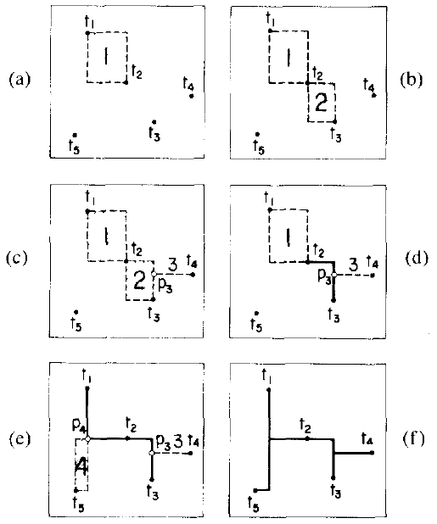
Watanabe’s PAR-2

Slide 108
A Multi-Terminal Routing Problem
10 |  | T1
9
8 |  |  |  |  |  |  |  |  |  | T4
7
6
5
4
3 |  |  | T3
2
1 |  |  |  |  |  |  |  |  | T2
0
 | 0 | 1 | 2 | 3 | 4 | 5 | 6 | 7 | 8 | 9 | 10 | 11
Input File:
.chip (0 0) (11 10) .pin 4 1 (1 10) 2 (8 1) 3 (2 3) 4 (9 8) .obs 8 (4 9) (4 10) (1 6) (3 7) (4 2) (4 6) (5 4) (5 4) (2 1) (4 1) (7 6) (11 6) (9 5) (9 5) (6 2) (8 2)

Slide 109
A Multi-Terminal Routing Problem
10 |  | T1
9
8 |  |  |  |  |  |  |  |  |  | T4
7
6
5
4
3 |  |  | T3
2
1 |  |  |  |  |  |  |  |  | T2
0
 | 0 | 1 | 2 | 3 | 4 | 5 | 6 | 7 | 8 | 9 | 10 | 11
A Sample Output File:
.net (1 10) (1 8) (0 8) (9 8) (0 8) (0 3) (0 3) (2 3) (6 8) (6 3) (5 3) (6 3) (5 3) (5 1) (8 1) (5 1) .total_wire_length 30 .num_of_vias 7

